Slide 1
Topic outlines
1. Objectives of pulp washing
2. Principles of pulp washing
3. Washing equipments
4. Multi-stage counter-current washing
5. Washing parameters and efficiency

Slide 2
Washing equipments
1. Rotary Vacuum Washer
2. Rotary Pressure Washer
Diffusion Washers
  - Continuous digester hi heat washing
- Atmospheric diffusion washer
- Pressure diffusion washer
4. Wash Press

Slide 3
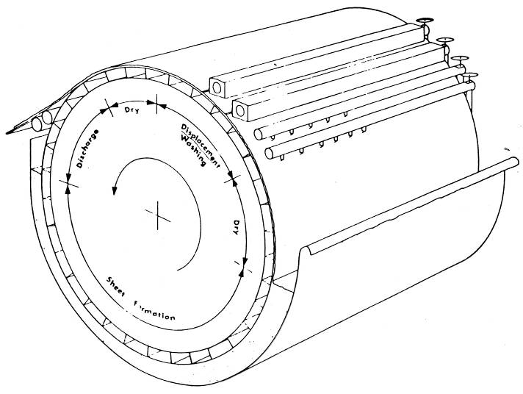
Principle of vacuum drum washer
PULP DISCHARGE
Cons 12-14%
Wash water
shower
PULP INLET
Cons 1%
VAT LEVEL

Slide 4
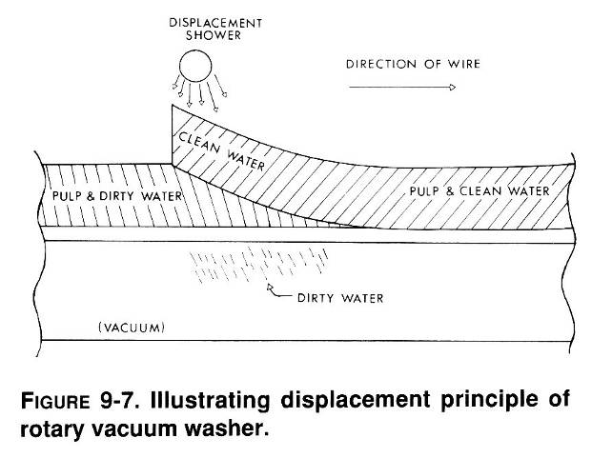
Displacement principle of rotary vacuum washer

Slide 5
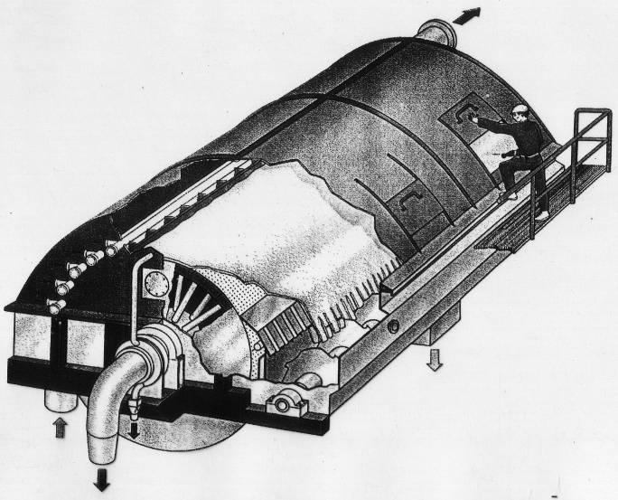
Structure of vacuum drum washer
VENT
PULP DISCHARGE
PULP INLET
FILTRATE

Slide 6
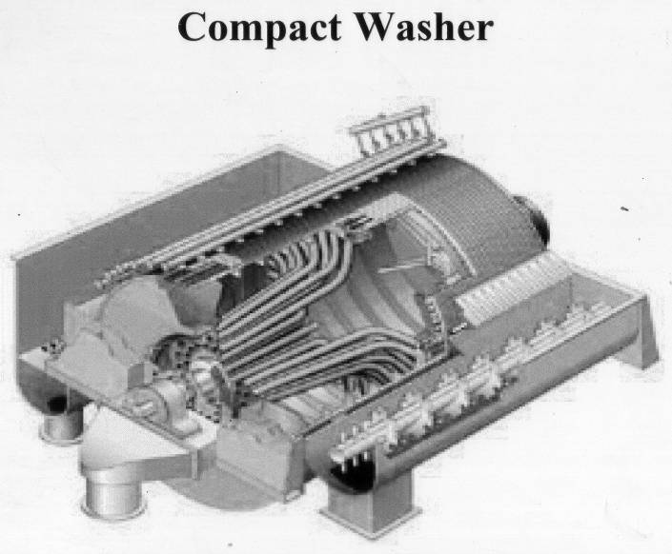
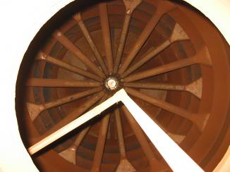
Internal of vacuum drum washer

Slide 7
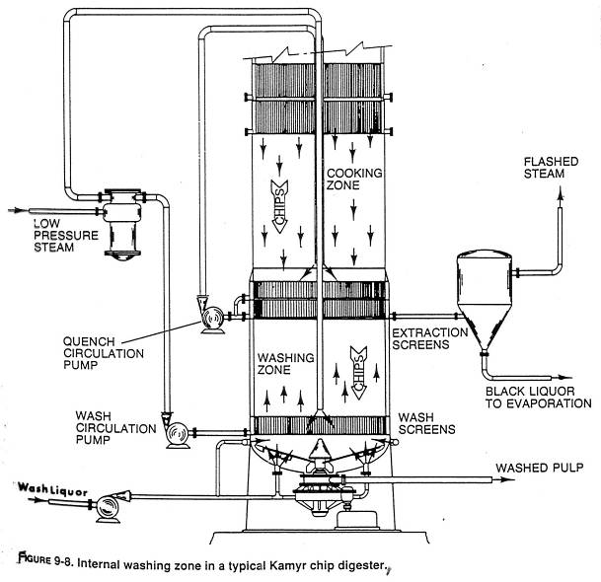
Washing zone in Kamyr digester

Slide 8
Topic outlines
1. Objectives of pulp washing
2. Principles of pulp washing
3. Washing equipments
4. Multi-stage counter-current washing
5. Washing parameters and efficiency

Slide 9
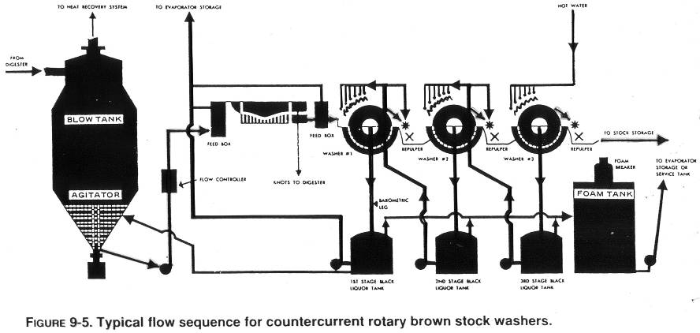
Multi-stage counter-current washing

Slide 10
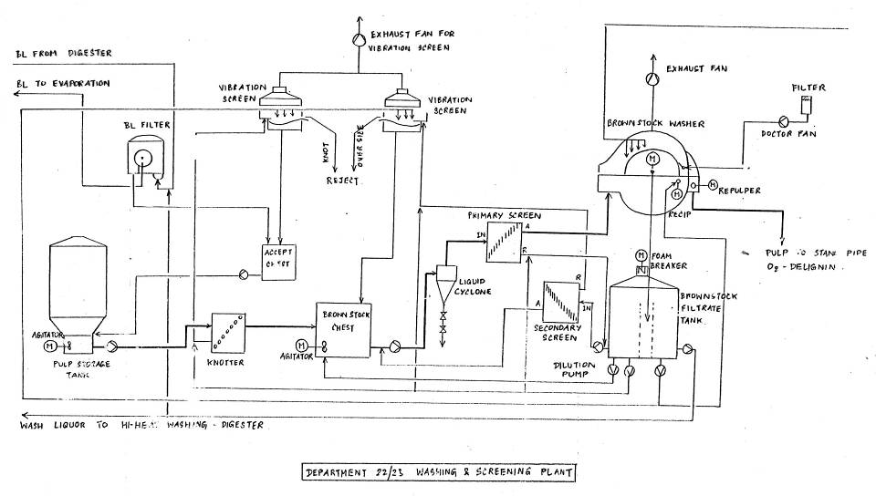
Brown stock washing plant (SCL)

Slide 11
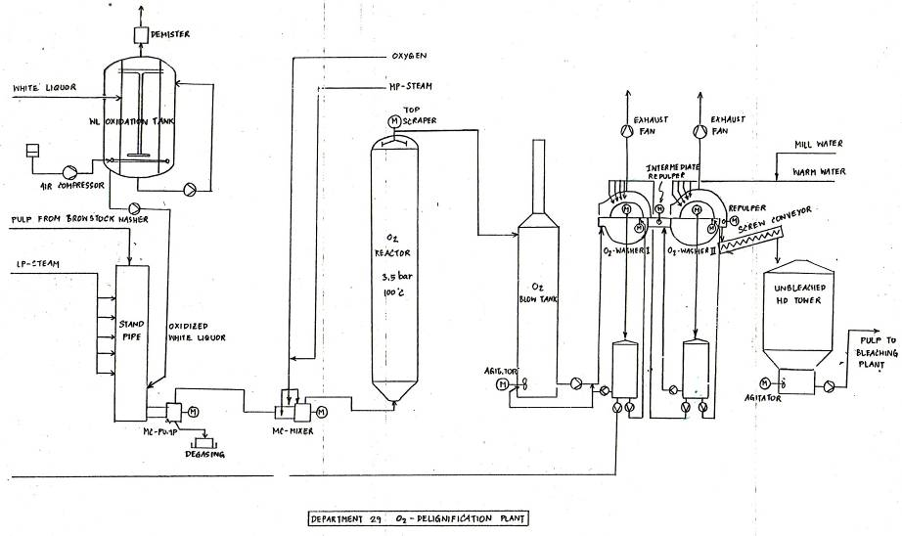
Washing after O2 delignification plant (SCL)

Slide 12
Topic outlines
1. Objectives of pulp washing
2. Principles of pulp washing
3. Washing equipments
4. Multi-stage counter-current washing
5. Washing parameters and efficiency

Slide 13
Ideal Washing Efficiency
1. Volume of Wash liquor = Liquor in pulp
2. %Solid in pulp discharge = %solid of wash liquor

Slide 14
Measuring Washing Efficiency
Dilution Factor
Displacement ratio
Thickening Factor
Overall Washing Efficiency

Slide 15
Dilution Factor
Define as the amount of wash water applied in excess of the amount required for total displacement.
Expressed in pounds of water per pound of dry pulp produced.
Perhaps most important economic indicator of system efficiency.

Slide 16
DILUTION FACTOR :
Expresses the quantity of water used for washing pulp
DF = kg WASH WATER – kg WATER IN PULP LEAVING THE WASHER
BD kg PULP
Typical Dilution factor = 1.0-2.5

Slide 17
DILUTION FACTOR :
= Total Water to washer – (100-discharge consist)(Flow pulp*input consist)
discharge consist 100
Flow pulp*input consist
100
Total water leaving the washer = {(100-C_{d})*P_{d}}/100
Concept
BDT_{input} = BDT_{discharge}
P_{in}*C_{in} = P_{d}C_{d}
P_{d} = P_{in}*C_{in}
C_{d}
Total water leaving the washer = {(100-C_{d})* P_{in}*C_{in}}/100 C_{d}
= (100-C_{d})(P_{in}*C_{in})
C_{d} 100

Slide 18
DILUTION FACTOR :
Total water flow = P₁
P_{d} = ??
C_{d} = C₂
P_{in} = P₂
C_{in} = C₃
DF = P₁- { (100-C₂) x (P₂xC₃) }
C₂ 100
P₂xC₃
100

Slide 19
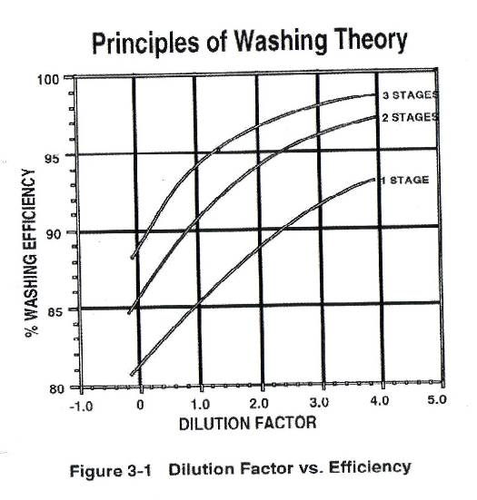
Principles of washing Theory

Slide 20
Question 1.
ประสิทธิภาพของการล้างเยื่อขึ้นกับน้ำที่ใช้ล้างเยื่อ และปริมาณที่ล้าง ถ้าเป็นเช่นนั้น ทำไมถึงไม่ใช้น้ำล้างเยื่อมากๆ
ความสามารถในการเกาะของเยื่อบน Wire
เพิ่มภาระที่ Evaporator เนื่องจากมีน้ำส่งไปมาก

Slide 21
Displacement Ratio (อัตราส่วนการแทนที่ด้วยน้ำล้างเยื่อ)
Key measurement of ability to evenly displace high concentration liquor with low concentration liquor.
Influenced by :
  Dilution factor, solids content, temperature, fiber length and air content

Slide 22
DISPLACEMENT RATIO (DR) :
Expresses the effectiveness of Displacement washing effect in removing solids from the pulp
DR = Cv – Cs Ideal DR = 1.0
Cv – Cw (Cs = Cw)
Cv = %Solids ของ Black liquor ในเยื่อที่ป้อนเข้า Washer
Cs = %Solids ของ Black liquor ในเยื่อที่ออกจาก Washer
Cw = %Solids in wash water

Slide 23
Thickening Factor
Used to express the drainage character of a washing system.
Ratio of actual liquor drainage to the maximum possible liquor drainage through fiber mat.

Slide 24
THICKENING FACTOR (TF) :
Expresses the effectiveness thickening effect on removal of dissolved solids
TF = W(in) – W(out)
W(in)
W(in) = kg of liquor per kg pulp (stock entering)
W(out) = kg of liquor per kg pulp (stock leaving)
W = 100 – Cons
Cons

Slide 25
THE OVERALL WASING EFFICIENCY :
Expresses the overall efficiency in removing dissolved solids from the pulp
Combination of displacement efficiency and thickening efficiency
% Efficiency = [TF + (1-TF)xDR] x 100

Slide 26
WASHING LOSSES
Efficiency of the washing systems
SODA LOSS
Expresses the sodium content remaining in the pulp
leaving the washing systems
- Soda makeup in the cycle
COD LOSS
Expresses the water-soluble organic matter
remaining in the pulp leaving the washing systems
- consume more bleaching chemicals

Slide 27
การวัดประสิทธิภาพการล้างเยื่อด้วย Soda Loss
Soda Loss
- เป็นการวัดประสิทธิภาพของระบบการล้างเยื่อ
- แสดงปริมาณโซเดียม (Na) ที่เหลือในเยื่อ หลังจากผ่านระบบ Washing
- มีหน่วยเป็น kg as Na₂O/ton เยื่อ
ผลกระทบของ Soda Loss สูง
- Na (ทั้ง Na2CO3, Na2O และ NaOH) หายไปจากระบบ ทำให้ต้องเติมชดเชยที่
ระบบ น้ำยาเคมีกลับคืน (เช่น loss 10 kg as Na2O/ADT เยื่อต้องเติมชดเชย 10
kg Na2O/ADT เยื่อ)
- ถ้าเป็นระบบฟอกเยื่อ จะกินสารเคมีในการฟอก Chlorine
- ผลกระทบต่อสิ่งแวดล้อม

Slide 28
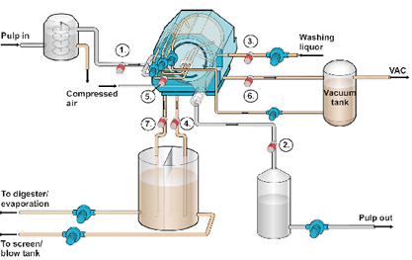
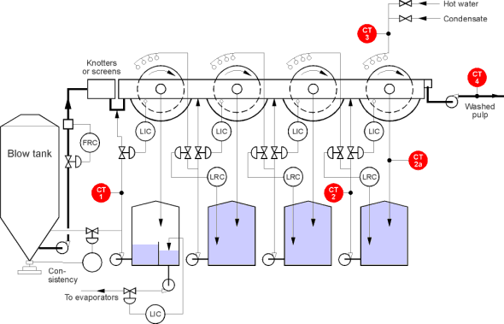
4. Overview of Pulping methodology
Drum Washer
Drum washer is use for washing the chemical and lignin (Filtrate Water) out so the Fiber/Pulp can be separate and send to other stage.
Normally, they are connected in series the filtrate water from the last stage can be reuse as wash liquor in the early washing stage.
Pulp out
Ref: http://www.kpatents.com/images/press/news13_image.jpg
Ref: http://www.rdt.co.kr/kemotron/99024-1.gif

Slide 29
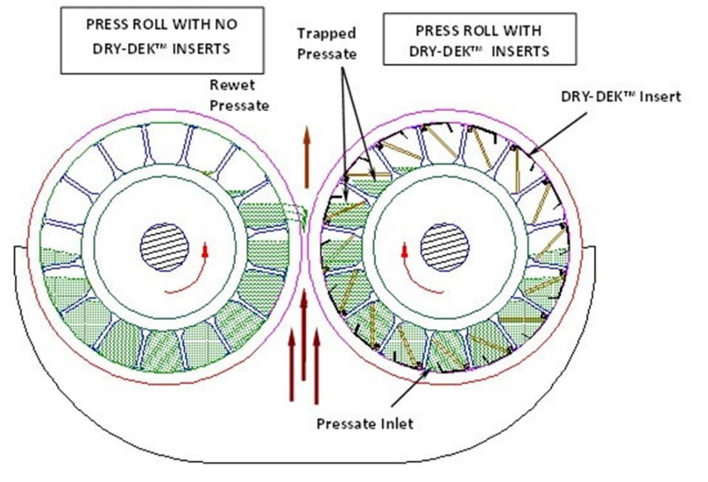
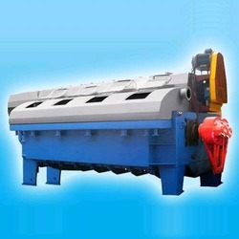
4. Overview of Pulping methodology
Twin Roll Press / Wash Press
Wash Press has a similar principle as washer but it use pressure to press the liquor out of the Fiber/Pulp. The liquor is also collected as “Filtrate” and the fiber is deliver to the next stage.
Twin Roll Press is more efficient in term of dewatering the liquor out of the fiber. Therefore, the Soda Loss is less than the normal washer.
Ref: http://cdn.glvpulppaper.com/Products/2146_2473_Dry-Dek-2-revised.jpg

Slide 30
5. Bleaching sequences

Slide 31
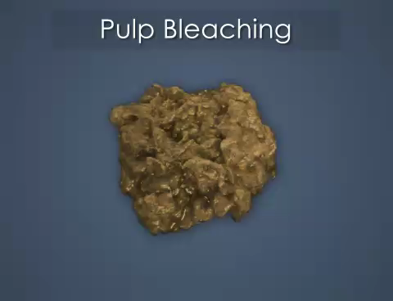
5. Bleaching sequences
Credit: Convergence Training

Slide 32
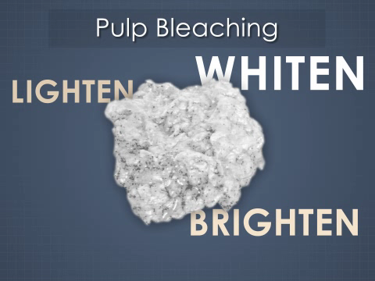
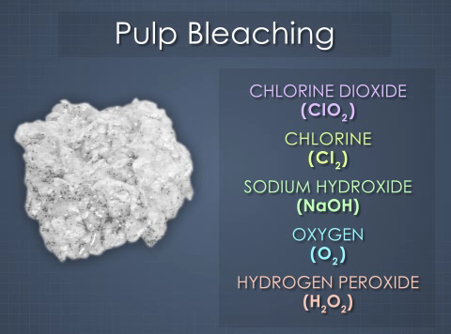
5. Bleaching sequences
The purpose of pulp bleaching is to lighten, brighten, or whiten the pulp. This can be done with several different chemicals. The most commonly used chemicals are:
• Chlorine Dioxide
• Chlorine
• Sodium hydroxide
• Oxygen
• Hydrogen Peroxide
Credit: Convergence Training

Slide 33
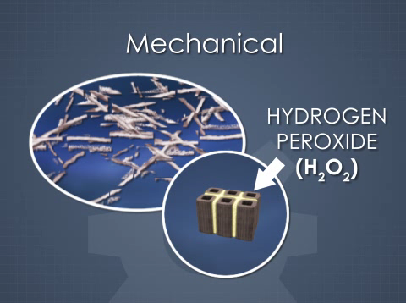
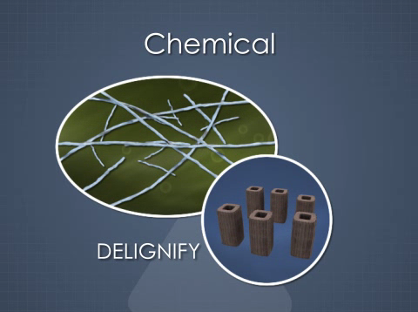
5. Bleaching sequences
The goal of bleaching is different for mechanical and chemical pulps. Mechanical pulps still contain most of the lignin from the wood, and so these pulps are bleached with chemicals like hydrogen peroxide that alter the lignin to make it less dark. This lightens and brightens the pulp.
Chemical pulps contain much less lignin and the goal of the bleaching chemicals is to remove the remaining lignin from, or "delignify," the pulp.
Credit: Convergence Training

Slide 34
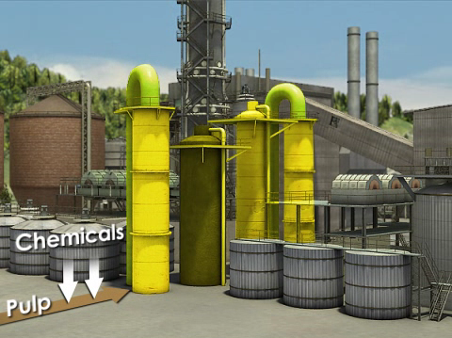
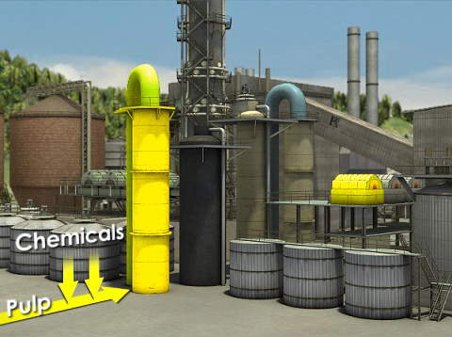
5. Bleaching sequences
2) Washing
Stage
3-5 Chemical Stages
1) Reacting
Stage
The chemicals are typically applied one or two at a time, in "stages." In each stage, the pulp is mixed with the chemical or chemicals, given time to react in a tank or "tower," and then washed with water. The number and order of the stages varies, but most "bleaching sequences" contain 3 to 5 stages.
Credit: Convergence Training

Slide 35
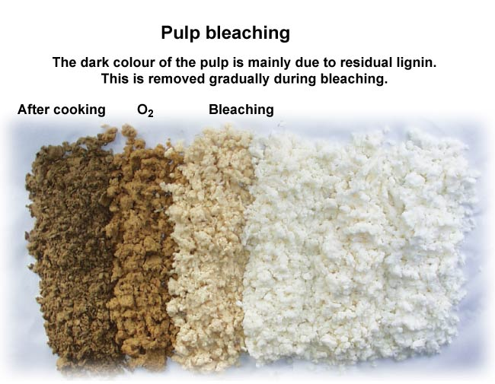
5. Bleaching sequences

Slide 36
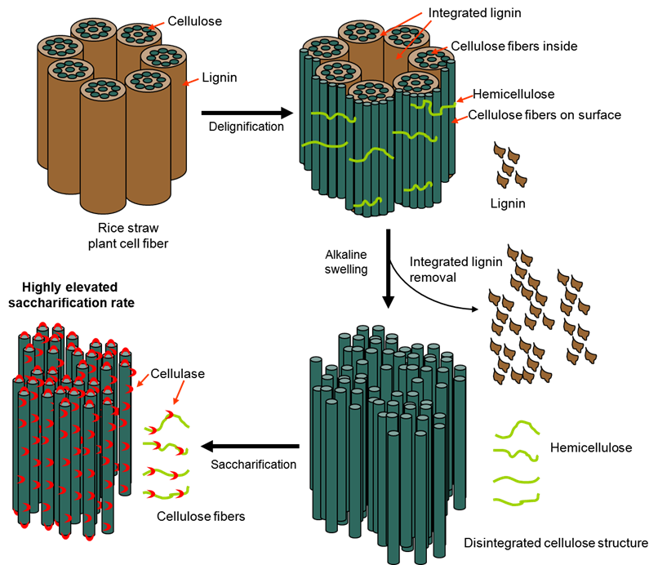
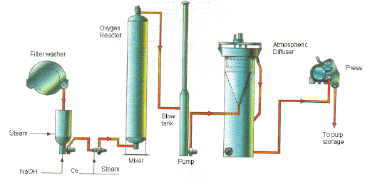
5. Bleaching sequences
Delignification
Oxygen is use at this stage to break the bond between Lignin and Fiber/Pulp after cooking stage. This effect the pulp color to be come light brown.

Slide 37
Oxygen Delignification

Slide 38
Oxygen Delignification Outline
Objective of Oxygen Delignification & Benefit
Oxygen Delignification Process
Double Stage Delignification
Operation and Control

Slide 39
Oxygen Delignification Outline
Objective of Oxygen Delignification & Benefit
Oxygen Delignification Process
Double Stage Delignification
Operation and Control

Slide 40
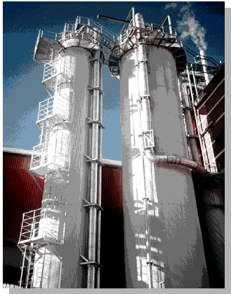
What is Oxygen Delignification?
Process use to continue the
delignification of the Pulp
(Removal Lignin)
Maximum Kappa reduction and
good pulp Bleachability
More selective than cooking stage
Less Cellulose degradation

Slide 41
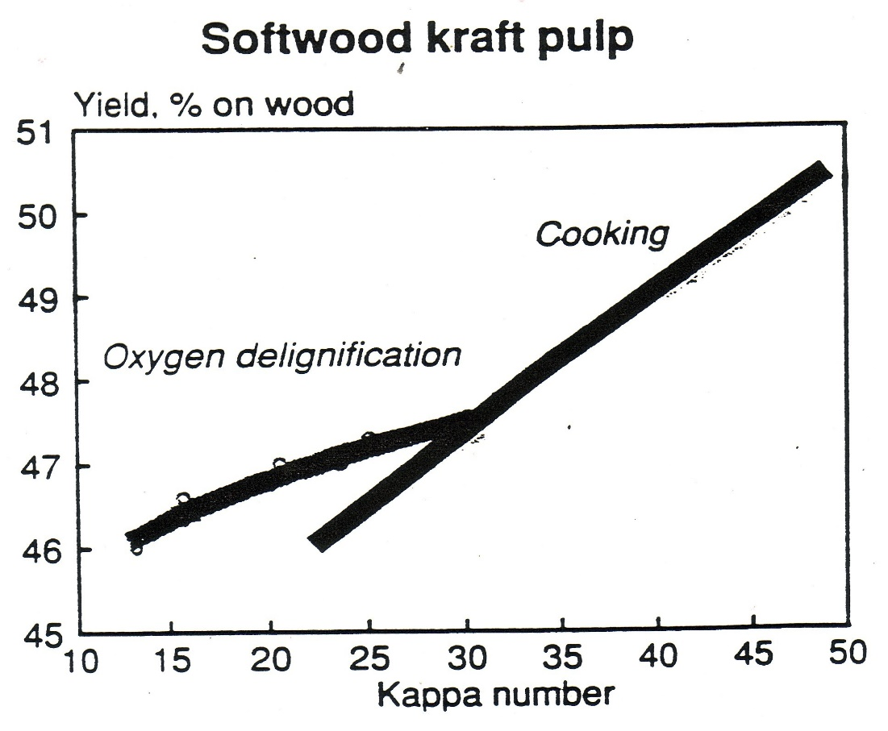
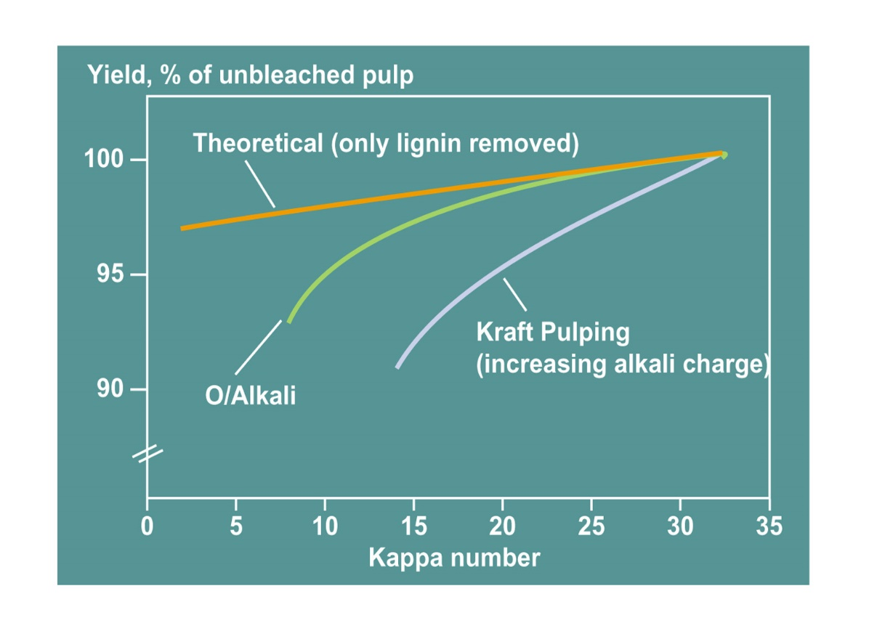
Why Oxygen Delignification?

Slide 42
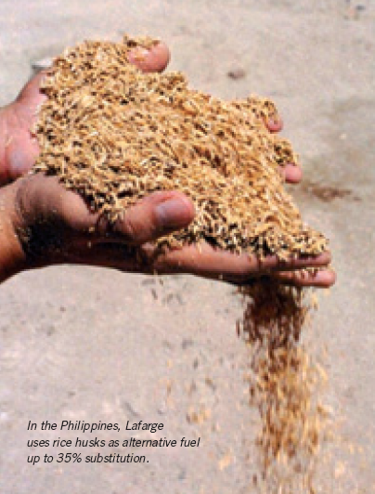
Benefits of Oxygen Delignification
Economics – Bleaching Chemical
Cost saving
Environmental Benefits
Energy Recovery – Recovery of heat
by burning lignin removed from the
pulp

Slide 43
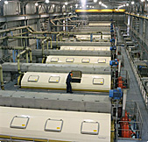
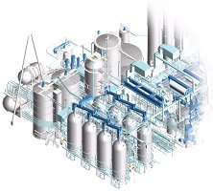
Bleaching Chemical Cost Saving
Due to reductions in the need of
Chlorine, caustic and chlorine dioxide
(Less bleach plant incoming kappa no.)
Oxygen cost in O2 delignification is
Cheaper material

Slide 44


O2 Delignification Environmental Benefits
Reduction in bleach plant effluent BOD,
Color and Organic Chlorine Compounds
Dissolved material (no Chlorine Contaminated)
Is recycled back to Recovery Boiler.

Slide 45
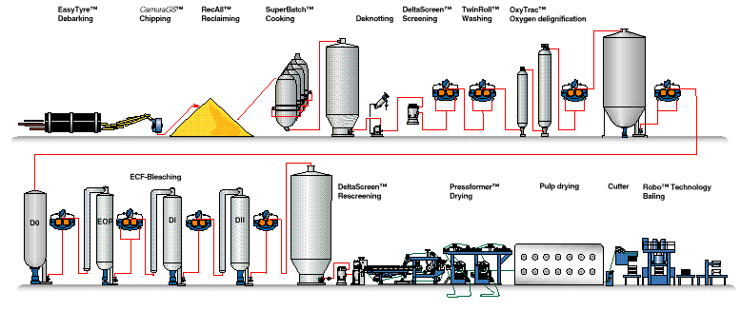
Energy Recovery
Recovery organic material (lignin) from unbleached
part to bunt as fuel in Recovery Boiler
Fresh
Water
Weak Black Liquor (WBL)
Soluble lignin (COD, dissolved lignin)
from brown stock washing goes to
recovery boiler
Unbleached
Bleached
Dissolved lignin and extra bleaching
Chemicals from bleaching is pollution and
goes to effluent treatment plant.

Slide 46
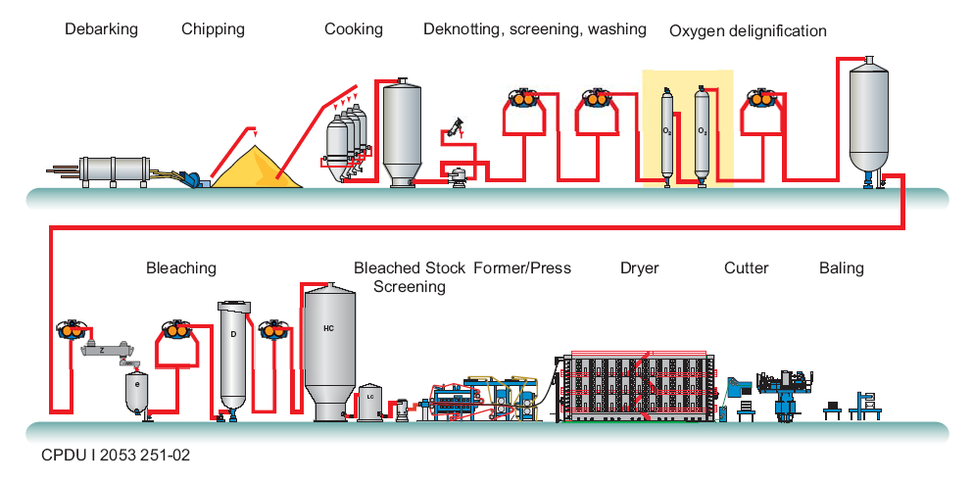
Where Oxygen Delignification?
Oxygen Delignification

Slide 47
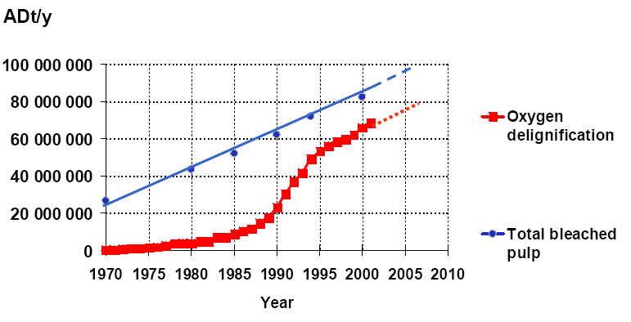
Growth of Oxygen Delignification

Slide 48
Oxygen Delignification Outline
Objective of Oxygen Delignification & Benefit
Oxygen Delignification Process
Double Stage Delignification
Operation and Control

Slide 49
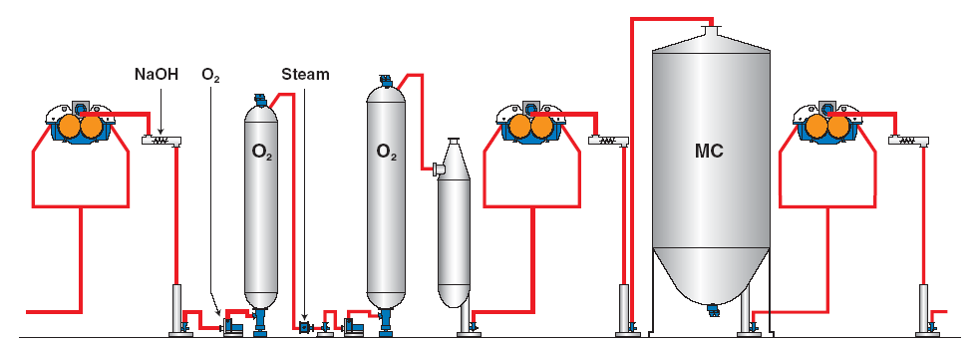
Oxygen Delignification Process

Slide 50
Oxygen Delignification Equipment
MC-Pump
MC-Mixer
Reactor
Discharger/Distributor
MC-Pump
Blow Tank
Washer (Twin Roll Press)
4.
4.
7.
4.
7.
7.
3.
3.
6.
1.
2.
1.
2.
1.
5.
1.

Slide 51
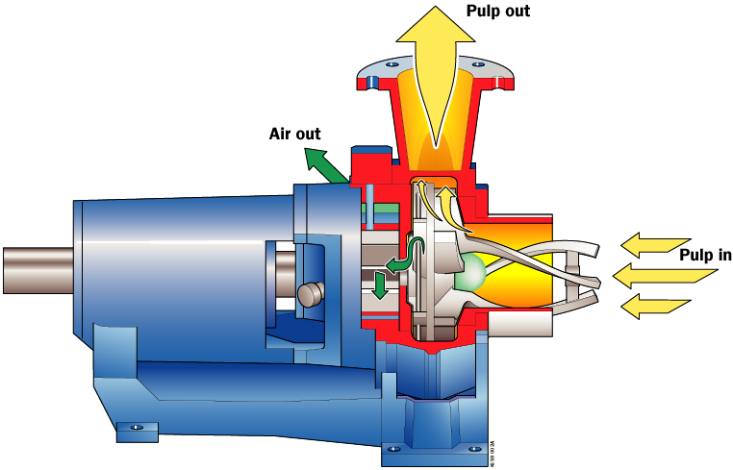
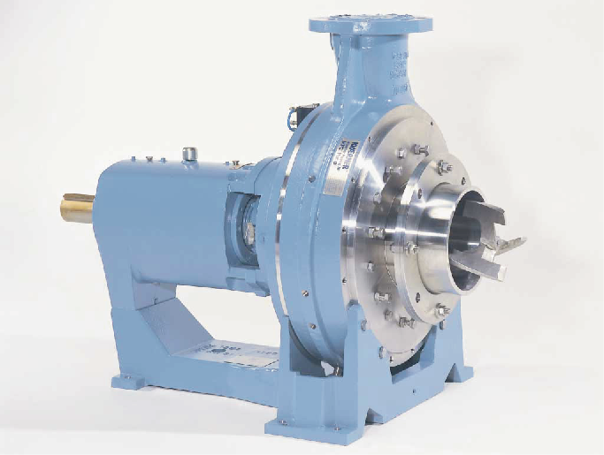
MC-Pump
Use for pump at medium consistency
(10-12)% to Reactor
Have internal or external vacuum
system for removal air in pulp

Slide 52
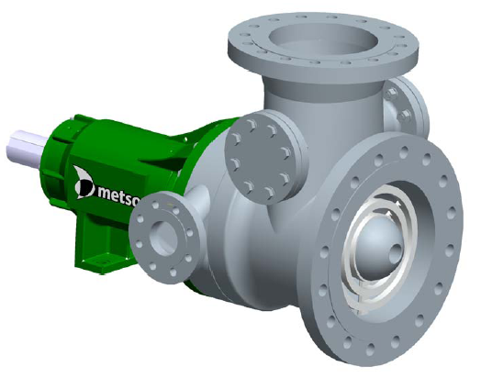
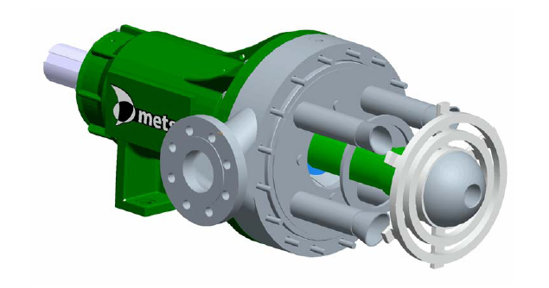
MC-Mixer
High shear mixer
To thoroughly mix a pulp suspension
with gas or liquid ex Oxygen, Steam

Slide 53
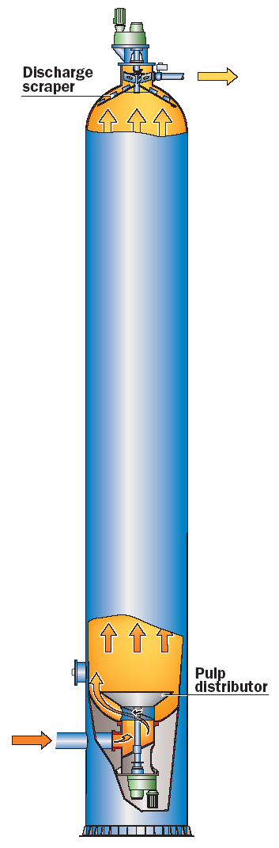
Reactor
Control Temperature and Pressure
Control Reaction Time

Slide 54
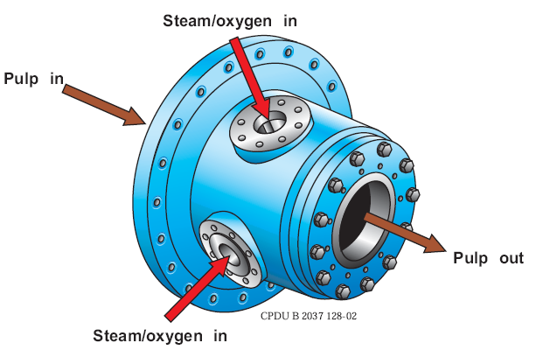
Heater
To heat the pulp suspension with
medium pressure (MP) steam

Slide 55
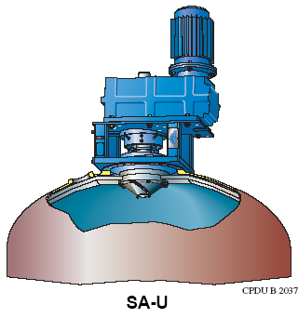
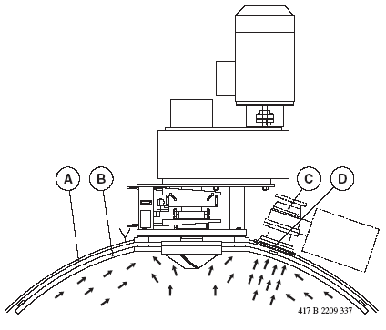
Top Scrapper
To discharge an even pulp flow from
a top of a tower/Reactor
Flow scraper sweeps around the
spherical head to prevent the pulp from
becoming stagnant in any one area
To transports the pulp to discharge
nozzle

Slide 56
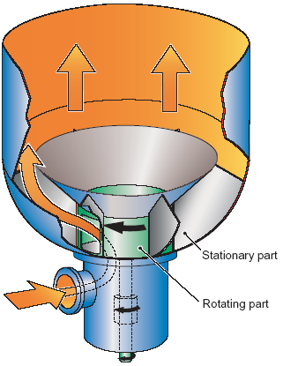
Distributor
To distribute an even pulp flow into
a bottom of a tower/Reactor
To transports the pulp to discharge
nozzle

Slide 57
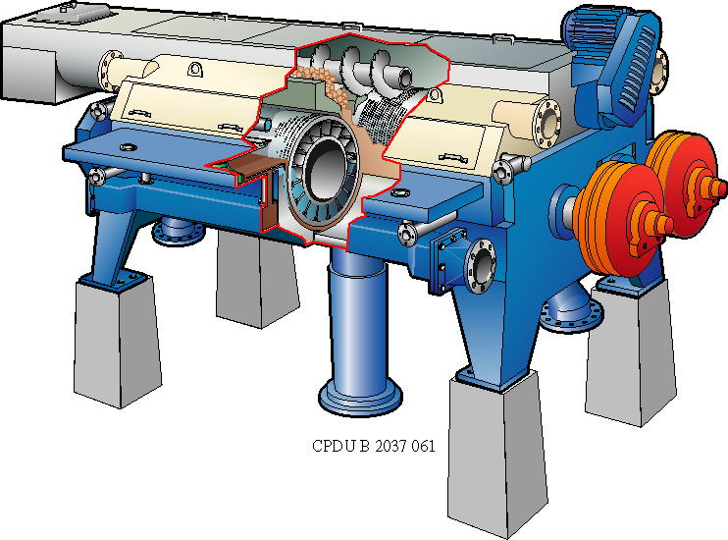
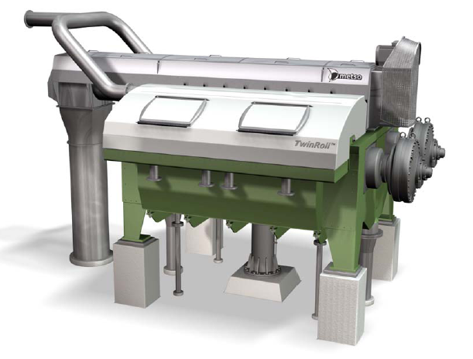
Washer (Twin Roll Press)
To Wash Pulp suspension using
Dewatering and Displacement
Washing Principle

Slide 58


Slide 59
Oxygen Delignification Outline
Objective of Oxygen Delignification & Benefit
Oxygen Delignification Process
Double Stage Delignification
Operation and Control

Slide 60
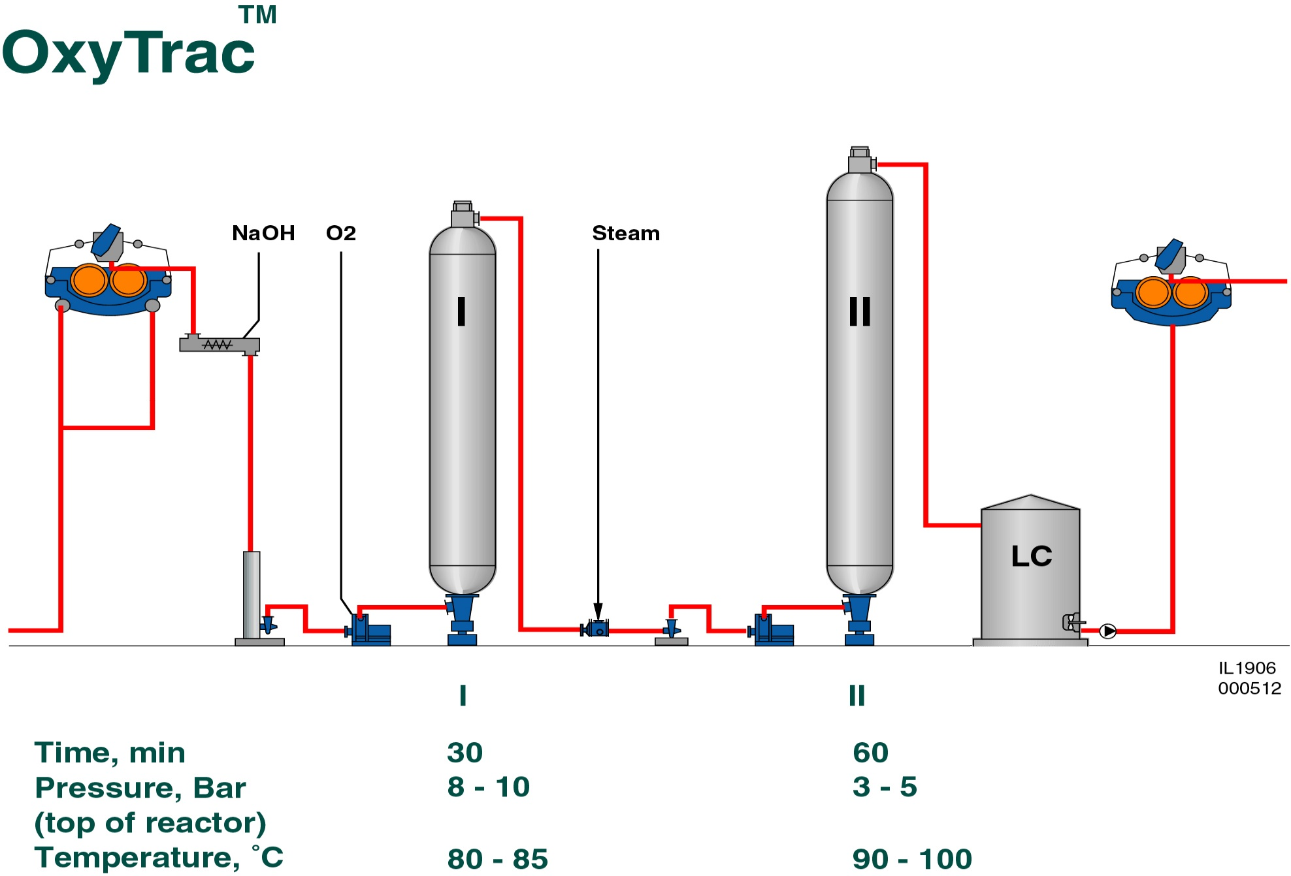
Double Stage Oxygen Delignification

Slide 61
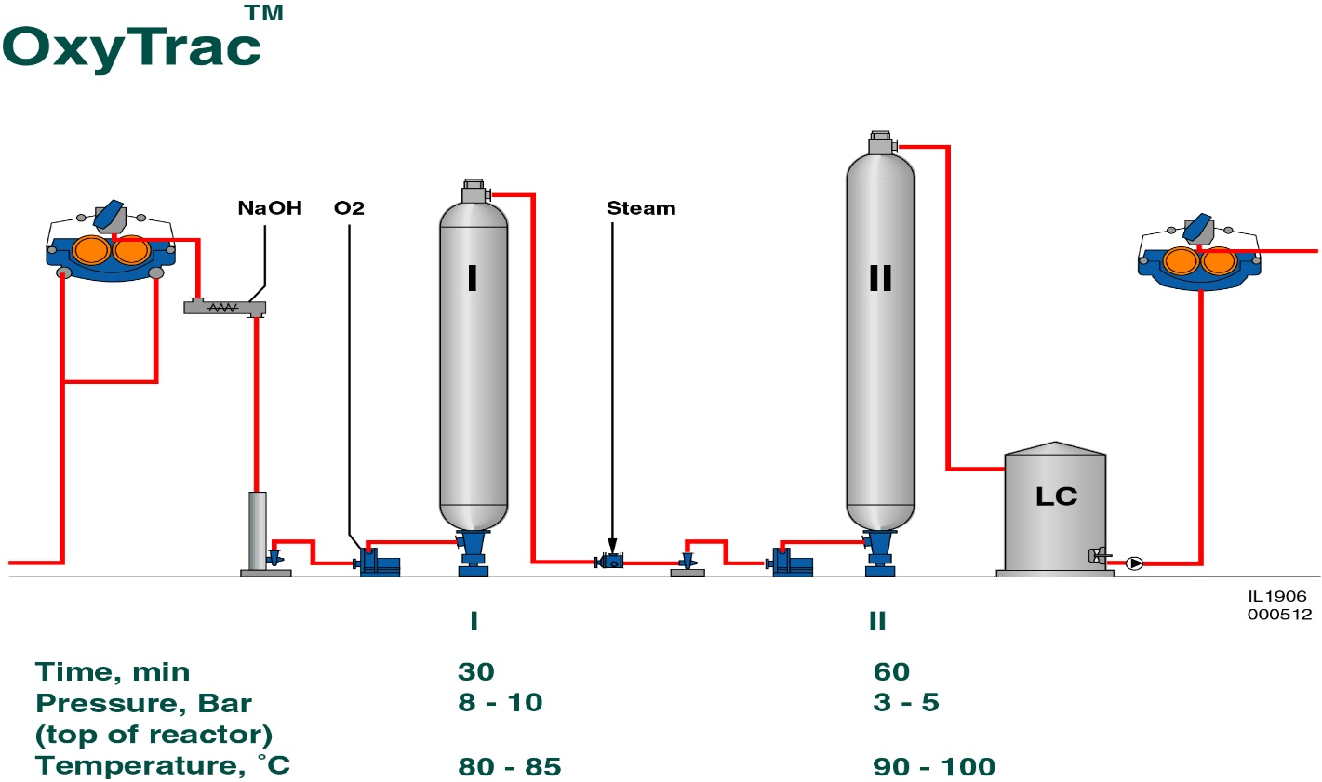
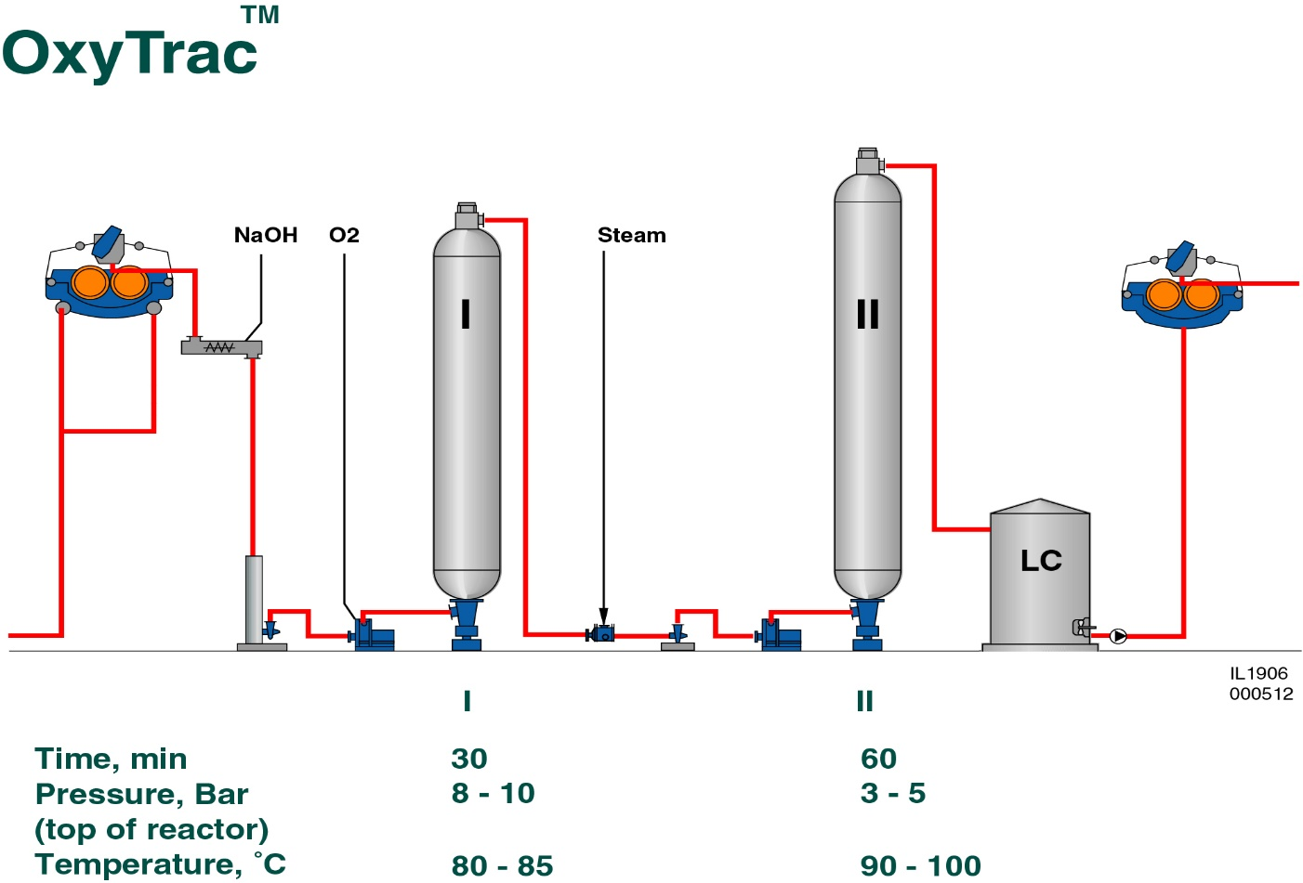
What Different compare with Single Stage
Single Stage Delignification
I
Double Stage
Delignification

Slide 62
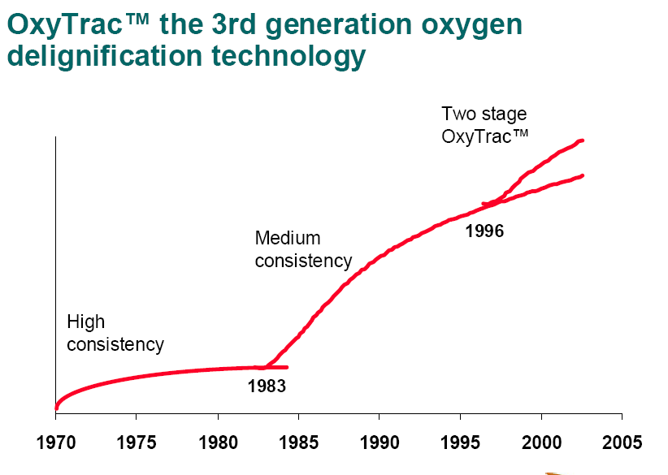
Two Stage the 3rd generation Oxygen
Delignification technology

Slide 63
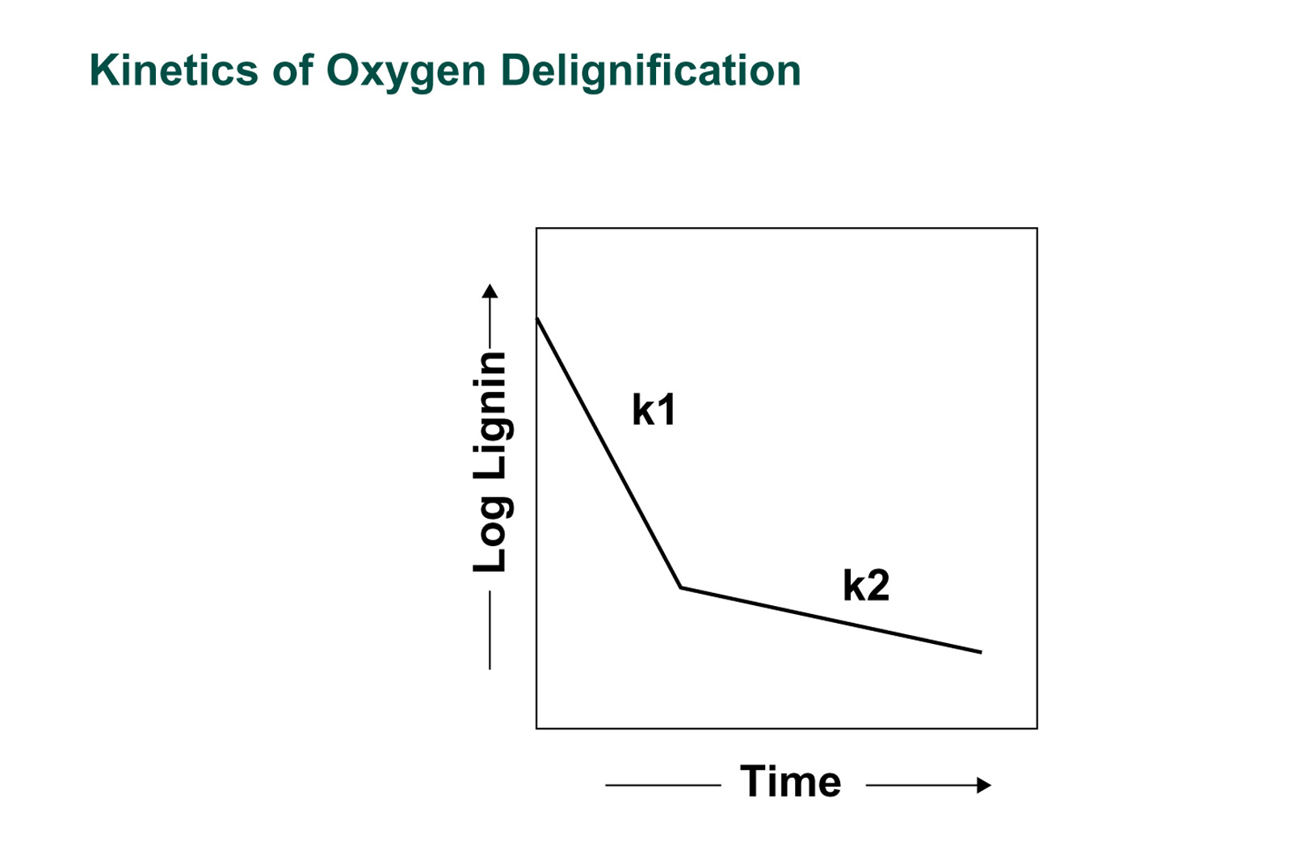

Kinetic of Oxygen Delignification

Slide 64
Double Stage Oxygen Delignification Condition
Reactor 1 2
Time, min 30 60
Pressure top of reactor, bar 8 – 10 3 – 5
Temperature, ºC 80 – 85 90-100

Slide 65

Double Oxygen Delignification Benefit
Major Benefits
Enhanced delignification without
sacrificing fiber quality
Preserve yield
Decrease the effluent load (the amount of
pollutants that are discharged to the
receiving water)
High Kappa reduction (Delignification Degree)
- Softwoods up to 70%
- Hardwoods up to 50%
Achieve higher pulp brightness
Decrease the chemical demand in the
bleaching area
Improve pulp strength

Slide 66

Oxygen Delignification Yield Single Vs Double

Slide 67

Double Stage Compare to Single stage

Slide 68

Double Stage Compare to Single stage

Slide 69

Double Stage Compare to Single stage

Slide 70

Kinetic of Oxygen Delignification

Slide 71





SCL Double Stage Oxygen Delignification
SCL Single Stage
SCL Double Stage

Slide 72
Benefit of Double Stage ODL at SCL
Cost reduction
Totally saving = 555Baht/ADT
= 47.7MB/Y @86,000ADT

Slide 73
Benefit of Double Stage ODL at SCL
Reduce COD and Color of Waste water
Waste water parameter | Unit | Before | After | Diff (%) | Cost saving (Baht/Y)
Color waste water discharge | ADMI | 2,512 | 1,390 | 45% | -
Color PG8 SCL | ADMI | 1,225 | 857 | 30% | -
COD | mg/l | 2,153 | 1,493 | 31% | -
Alum | mg/l | 975 | 641 | 34% | 7.2
ข้อมูล : จากบันทึก เรื่อง ปริมาณสีก่อนและหลังการปรับปรุง Double Oxygen ของ SCL
โดย แผนกจัดการสิ่งแวดล้อม TKIC เมื่อวันที่ 25 ก.พ.2549

Slide 74
Benefit of Double Stage ODL at SCL
Reduce COD and Color of Waste water

Slide 75
Benefit of Double Stage ODL at SCL
Improve Pulp quality
Pulp properties | Unit | AA (Act’05) | PHOENIX (Act’05) | SPPC (Act’05) | SCL (Act’05) | SCL (Act’06) | Diff SCL 05’-06’
Tensile index | Nm/g | 45.3 | 45.1 | 44.6 | 52.3 | 54.7 | +2.4
Tear index | mNm2/g | 7.7 | 8.0 | 5.9 | 7.1 | 7.9 | +0.8
Stiffness index | mN.m2/g | 0.9 | 1.0 | 1.2 | 1.0 | 1.0 | 0.0
Opacity | % | 81.0 | 80.9 | 84.8 | 81.2 | 80.5 | (0.7)
Brightness | %ISO | 89.1 | 89.2 | 83.8 | 85.0 | 85.7 | +0.7
Dirt count | ppm | 0.2 | 0.19 | 1.1 | 0.38 | 0.28 | +0.1
Shives | ppm | 0.0 | 0.06 | 1.7 | 0.51 | 0.20 | +0.31

Slide 76


Summary Benefit of Double Stage ODL at SCL
Technology selected: Metso OxyTrac Oxygen Delignification
Scheduled startup: Dec 05
Actual Start up : 25 Dec 05
Budget Approved : 94.5 MB
Actual expensed : 98.7 MB (-4.4%)
Benefits : Total 55 MB/y
Chemicals saving 555 Baht/ADT (48 MB/y)
Reduction of waste water color by 45%
and COD load by 30% → saving of Alum (7 MB/y)
Improve pulp quality: Tear index by 10%, Tensile index by 5% Brightness 85% → 86% ISO
Performance test : Fulfilled on 28 Feb06

Slide 77
Benefit of Double Stage ODL at SCL
COD, Soda loss : kg/BDT
Chemical : kg/ADT

Slide 78
Oxygen Delignification Outline
Objective of Oxygen Delignification & Benefit
Oxygen Delignification Process
Double Stage Delignification
Operation and Control

Slide 79

What we concern about Delignification?
Reliability of Operation
Delignification Degree
Chemical Dosage
- Oxygen
- NaOH
Process Condition
- Pressure, Temperature,
%consistency, Reaction Time,
and End-PH

Slide 80
Delignification Degree
K_{in} - K_{out}
Delignification Degree =
K_{in}
K_{in} ~ Kappa no. before O2 delignification
K_{out} ~ Kappa no. after O2 delignification
Normal delignification degree ~ 40-50% (Hard Wood)
K_{in}
K_{out}

Slide 81
Chemical Dosage
Alkali Charge
1.5 - 2.5 kg NaOH per ADT and Kappa number decrease for Softwood
2.0 – 3.0 kg NaOH per ADT and Kappa number decrease for hardwood
Kappa number decrease = the incoming kappa
Number minus the set point for the outgoing

Slide 82
Chemical Dosage
Oxygen Charge
Oxygen Charge is proportional to the alkali charge,
it is usually 0.5 – 0.8 times the alkali charge,
(Upper Limit ~ 25 kg O₂/t)

Slide 83

Effect of NaOH Charge on %Delignification

Slide 84
Effect of too much Oxygen Dosage
High
Kappa in
Kappa reduction
Kappa Reduction
High O₂ Dosage
or Low Kappa in
=> Mixing Problem
=>Low Bleachability
O₂ Dosage
[kg/t]
TP60-K# O2-variables

Slide 85

Process Condition
Temperature
First Reactor is Low (80 - 85 ºC) so that the pulp fibers are protected
from degradation during delignification
Second Reactor is adjusted (90 - 105 ºC) so that alkali charge will be
consumed and end-PH of 10.5 to 11.0 is obtained.

Slide 86
Process Condition
End-PH
The end-PH is controlled to provide the best environmental for
Oxygen/lignin reaction to take place
The end-PH is controlled by dosage of alkali and the reactor temperature
End-PH ~ 10.5 to 11.0
Optimum
pH 10.5-11
NaOH
O₂
Steam
Kajaani
Filtrate Piston
Pre O₂ Kappa
Post O₂ Kappa

Slide 87
Process Condition
Pulp Consistency
Consistency is controlled with medium consistency(10-12%) because.
It is easier to transport the pulp,
Reaction Selectivity,
protect channeling in the Reactor
Pressure
The high pressure in the first Reactor help to keep the oxygen bubbles
Pressure in First Reactor ~ 8 – 10
Pressure in Second Reactor ~ 3 – 5 bar

Slide 88
Operating Condition Summary
Parameter | 1st Stage | 2nd Stage
Alkali Charge | 2.0 – 3.0 kg/ADT/ΔKappa | -
Oxygen Charge | 0.5 – 0.8 times the alkali charge
End-PH | - | 10.5 – 11.0
Temperature | 80 – 85 ºC | 90 – 105 ºC
Pulp Consistency | > 11% | > 11%
Residence Time | 30 min | 60 min
Pressure Top | 8 – 10 bar | 3 -5 bar

Slide 89

Operation Guideline

Slide 90
Example
Ex1 If the kappa number inlet is 24 and the desired kappa
number outlet is 11, and charge factor is 2.2 kg NaOH/t/kappa
number decrease, if production is 250 Adt/day, Alkali strength is
100 g/l,
1.1 How much Delignification Degree ?(%)
1.2 How much Alkali will be charged? (m3/h)
1.3 If Oxygen charge is 0.6 times the alkali charge, How much oxygen
Will be charged? (kg/hr)
1.4 If consistency of pulp inlet to Reactor is 10% , How much pulp
flow will be fed into Reactor? (m3/hr)
1.5 Finally If kappa no. Reduction and End-PH are too small,
What action to do? (Alkali charge and Temperature)

Slide 91
Pulp Bleaching
To Finish The Delignification of the Pulp and Brighten Any Lignin That Remains In the Pulp

Slide 92

5. Bleaching sequences
SCL Wangsala Pulp Mill
CHEMICAL PULP PROCESS DIAGRAM
250 adt/d, 65,000ADT/Y, Bleached Eucalypts pulp 85+1%ISO
Credit: Weerachai Seachao

Slide 93
Causes Of Pulp Fiber Coloration In Pulp Mill
Lignin
Resins
Metal Ions (i.e., Fe, Mn, Cu)
Hemicellulose

Slide 94
Objectives Of Pulp Bleaching
Mill Wants To Obtain a Pulp That Has the Following Qualities:
  High Brightness
  Low Dirt Count (Shives, Bark, Scale, Pitch, Etc.)
  Good Strength/High Viscosity*
  High Brightness Stability/Low Brightness Reversion

Slide 95
Objectives Of Pulp Bleaching
Brightening
Cleaning
Purification
Viscosity Is An Indirect Way Of Measuring Fiber Strength

Slide 96

5. Bleaching sequences
Bleaching

Slide 97
Factors Interfering With The
Achievement Of Bleaching Objectives
High Kappa No. Unbleached Pulp
Large Kappa No. Variation Of Unbleached Pulp
Poor Brown Stock Washing
Poor Bleach Plant Washing

Slide 98
Factors Interfering With The
Achievement Of Bleaching Objectives
High Shive Content
High Dirt Content From Bark, Pitch, Etc.
High Metal Ion Content In Pulp (Iron, Manganese)
Blinding of Process Control Sensors With Scale Or Pitch

Slide 99
Processes involved in Pulp Bleaching
  Delignification
  Extraction
  Brightening
  Washing

Slide 100
Bleach Chemicals Used in Pulp Mills
Delignifiers
  Oxygen (O₂)
  Chlorine Dioxide (ClO₂)
  Chlorine (Cl₂)
  Ozone (O₃)
Extracter
  Caustic (NaOH)
Brighteners
  Chlorine Dioxide (ClO₂)
  Chlorine (Cl₂)
  Sodium Hypochlorite (NaOCl)
  Peroxide (H₂O₂)

Slide 101
Selection of Bleach chemicals
Cost
Selectivity
Particle bleaching
Capital Investment
Hazard in handling
Availability
Hazard to Environment

Slide 102
Important Bleaching Parameters
pH: < 2 to remove heavy metals
> 10.5 to solubilize pitch
Retention Time
Temperature
Mixing
Consistency
Concentration of Bleach
Chemicals Being Added

Slide 103
Environmental concerns of Bleaching
“Chlorine an Environmental Hazard”
ECF Bleaching ( Elemental chlorine free)
TCF Bleaching ( Total chlorine free)
-Very expensive.Popular only in Europe

Slide 104
Ways To Reduce AOX & Dioxin Formation
Lower Brown Stock Kappa No.
Improve Brown Stock Washing
100% ClO₂ Substitution
Improve Mixing
Lower Temperature
Defoamers

Slide 105
Ways To Reduce AOX & Dioxin Formation
Eliminate Dioxin Formation
100% ClO₂ Substitution
Eliminate AOX Formation
  Use No Halides (Cl_{2,} ClO₂, NaOCl, Br₂, etc.) in Pulping or Bleaching Process

Slide 106
Trend in Chemical Pulping
Increased system closer
Extended delignification
ECF/TCF - bleaching

Slide 107

5. Bleaching sequences
Bleaching Development
Elemental Chlorine (Chlorine Gas)
Elemental Chlorine-Free (Chlorine Dioxide)
Total Chlorine-Free (Ozone)
Remarks: ECF is invented to prevents the formation of dioxins and dioxin-like compounds, carcinogens.

Slide 108
Definition of ECF, TCF
ECF Elemental Chlorine-Free Bleaching
= Bleaching without chlorine – gas
TCF Totally Chlorine-Free Bleaching
= Bleaching without chlorine -
compound

Slide 109
Symbols for Bleaching Stages
O = oxygen delignification
D = chlorine dioxide
E = alkali extraction
A = acid treatment at pH2
Z = ozone (pH 2)
Q = chelating treatment with EDTA
P = hydrogen peroxide
P* = hydrogen peroxide
with megnesium addition

Slide 110
Bleaching sequences to achive 85%ISO brightness
C-Eop-H
C-Eop-H1-H2
C-Eop-HED

Slide 111
Standard Bleaching 1992-2006
OD (Eop) D D

Slide 112
Modern Bleaching Sequences (Examples)
Typical ECF sequences
D-EOP-D
EOP-D-PO-D
D-EOP-PQ-PO
ZQ-EO-D-D
Typical TCF sequences
ZQ-PO-ZQ-PO
Q-EOP-PaaQ-PO
Shorter Sequences for
HW Pulp can be
ADQ-EOP-D
ZDQ-PO

Slide 113

A block diagram for the sequence C_{D}EODED is shown in Fig. 148,
Figure 148. Simplified bleach plant block diagram.

Slide 114

Figure 149. A tower and drum washer bleach plant.

Slide 115
Bleach Plant Process Control Scheme

Slide 116
Less impact to environment
Bleaching sequences:
ZQ-PO-ZQ-PO
Minimum effluent
Recycle to evaporotor
No chloride ion to corrode the evaporators, recovery boiler

Slide 117


Slide 118

Visual Process control

Slide 119
6. Principle of chemical recovery

Slide 120


6. Principle of chemical recovery
The used, inorganic pulping chemicals and dissolved, organic wood components that are washed out of sulfite and kraft pulps after cooking have value, so the wash water undergoes several process steps. First, it is concentrated by evaporating as much water as possible. Then, it is fired into a recovery boiler. Two things happen in the recovery boiler:
Credit: Convergence Training

Slide 121


6. Principle of chemical recovery
1. The used pulping chemicals are converted to a form from which fresh pulping chemicals can be made.
2. The organic wood components are burned to produce steam for use in several key mill processes.
Credit: Convergence Training

Slide 122


6. Principle of chemical recovery
Any water that entered the boiler with the concentrated wash water simply evaporates.
The recovery of the pulping chemicals and the production of steam are both critical to the economic viability of a pulp and paper mill. They also greatly reduce its environmental impact.
Credit: Convergence Training

Slide 123

6. Principle of chemical recovery
Ref: http://www.tappsa.co.za/archive2/APPW_2004/Title2004/Applying_best_sustainable_prac/2004-27fig1a.jpg

Slide 124



Chemical Recovery Section
Evaporator
Recovery Boiler
Recausticizing Plant

Slide 125
จุดประสงค์ที่มี Recovery Process
1. เพื่อจัดการน้ำดำ (Black Liquor) ที่เกิดจาก
กระบวนการล้างเยื่อให้กลายเป็น Caustic Soda เพื่อใช้เป็นสารเคมีในการต้มเยื่อกระดาษต่อไป
2. ผลพลอยได้จากการผลิตจะได้ Steam และ ไฟฟ้านำไปใช้ในกระบวนการผลิตต่อไป

Slide 126
Chemical Recovery Section
Wood/Non-Wood
Weak Black Liquor
Strong Black Liquor
Evaporator
Land Fill
Digester
(หม้อต้มเยื่อ)
Recovery
Boiler
Lime Kiln
Lime Mud
Lime Mud
Quick Lime
Smelt
เยื่อกระดาษ
Recausticizing Plant
Green Liquor
Water
Caustic soda/
Sodium Sulfide
Notes:
To describe process overview of chemical recovery section

Slide 127



6. Principle of chemical recovery
Evaporator
Evaporator: To Evaporate the water content in Black Liquor from Digester call “Weak Black Liquor” (appx.10 – 12 %Solid), After evaporate it become more viscose and concentrated (appx. 55 – 70% Solid) this is call “Strong Black Liquor” which is deriver to next stage

Slide 128
Evaporator
Evaporator มีหน้าที่สำหรับทำการต้มระเหยน้ำดำเจือจาง (Weak Black Liquor) ให้มีความเข้มข้นเพิ่มมากขึ้น (%Dry Solids สูงขึ้น)
เพื่อ
1. ให้สามารถใช้เป็นเชื้อเพลิงเผาไหม้ที่ Recovery Boiler ได้
2. ประหยัดพลังงานในการกระบวนการระเหยน้ำ (Drying) ใน
กระบวนการเผาไหม้ใน Recovery Boiler

Slide 129
Evaporator
หลักการทำงานโดยสังเขป
Steam
Vapour
Vapour
Vapour
Condensate
จาก Steam
Weak Bleach Liquor (เจือจาง)
Strong Black Liquor (เข้มข้น)
ความเข้มข้น 10-11% Dry Solids
ความเข้มข้น 48-49% Dry Solids

Slide 131
Evaporator

Slide 132
Evaporator

Slide 133
Evaporator
ชนิดของ Evaporator
1. Rising Film Evaporator
2. Falling Film Evaporator
ประสิทธิภาพสูงกว่า Rising Film

Slide 134
Evaporator
ชนิดของ Evaporator
1. Rising Film (RF) Evaporator เป็น Evaporator รุ่นเก่าซึ่งประกอบไปด้วย Shell และมีชุดท่ออยู่ภายใน เส้นผ่านศูนย์กลางโดยประมาณ 2” และจะทำการป้อน Black Liquor เข้าไปในชุดท่อโดย Pump และจะจ่าย Steam เข้ามาทำการระเหยน้ำใน Black Liquor นอกชุดท่อ ดังรูป
Vapour Out
Steam in
Liquor out
Liquor in

Slide 135

Rising Film Evaporator

Slide 136

Evaporator
Tube Evaporator

Slide 137
Evaporator
Rising Film (RF) Evaporator
ข้อเสียของ Rising Film (RF) Evaporator
1. ถ้าเดิน Load ต่ำกว่า 50% จะทำให้ประสิทธิภาพในการต้มระเหยต่ำและจะทำให้เกิดตัว Scale ในเส้นท่อได้ง่าย ซึ่งเนื่องมาจาก
1.1 การต้มระเหยจะไม่เสถียรเมื่อความเร็วของ Black Liquor ต่ำ
1.2 ที่ความเร็วต่ำจะทำให้เกิด จุดร้อน (Hot Spot) ซึ่งทำให้เกิด
Scale ได้
2. ถ้าเกิดการอุดตันของ Black Liquor ขึ้นในเส้นท่อจะทำการ Clean โดยใช้การล้างไม่ได้ จะต้องใช้การ Clean โดยเครื่องมือเท่านั้น

Slide 138


Evaporator
Scale in Evaporator Tube
จะเป็นตัวต้านทานการถ่ายเทความร้อน

Slide 139
Evaporator
Falling Film (FF) Evaporator
Evaporator ชนิดนี้จะทำการป้อน Black Liquor เข้าด้านใต้ Shell ของ Evaporator โดยมีการควบคุมระดับที่แน่นอนเอาไว้และจะทำการ Spray ตัว Black Liquor ไปด้านบนของแผ่น Plate (Heating Element) โดยจัด Pump ดังรูป และจะไหลลงมาเคลือบตัว Plate โดยน้ำหนัก โดยตัว Vapour หรือ Steam จะเป็นตัวให้ความร้อนอยู่ใน Plate โดยเราเรียก Plate ชนิดนี้ว่า “Lamella”

Slide 140

Evaporator
Falling Film Evaporator

Slide 141
Vapour Out
Black Liquor In
Vapour In
Black Liquor Out
Condensate

Slide 142
FREE FLOW FALLING FILM
EVAPORATOR UNIT

Slide 143
Evaporator
Falling Film (FF) Evaporator
ข้อดีของ Falling Film Evaporator
1. ประสิทธิภาพการต้มระเหยของ Evaporator ชนิดนี้จะไม่เปลี่ยนแปลงตาม Load มากนัก โดยสามารถเปลี่ยนแปลง Load ได้ 30 – 100 % เนื่องมาจาก
1.1 Circulation Rate คงที่อยู่ตลอดเวลา

Slide 144
Evaporator
m4 Steam in
(Ton/hr.)
Strong Black Liquor Out
Weak Black Liquor in
Q2 (m³/hr.)
Q1 (m³/hr.)
Evaporated Water
Q3 (m³/hr.)
อัตราการระเหยน้ำ (Q3) = Q2 – Q1 (m³/hr.)
อัตราส่วนน้ำที่ระเหย m³ = Q3
ใช้เป็นตัวบอกประสิทธิภาพของ
Evaporator
ขณะเดินเครื่อง
Steam ที่ใช้
Ton
m4

Slide 145
Live steam and liquor flows
STEAM t/h (FRCQ-001) | LIQUOR TO 1 AB m³/h (FRCQ-002) | STRONG LIQUOR m³/h (FR-010) | FEED LIQUOR m³/h (FIQ-003)
1 | 1,64 | 0,72 | 4,89
2 | 3,28 | 1,45 | 9,78
3 | 4,92 | 2,17 | 14,67
4 | 6,56 | 2,89 | 19,56
5 | 8,20 | 3,62 | 24,45
6 | 9,84 | 4,34 | 29,34
7 | 11,49 | 5,06 | 34,23
8 | 13,13 | 5,78 | 39,12
9 | 14,77 | 6,51 | 44,01
10 | 16,41 | 7,23 | 48,90
11 | 18,05 | 7,95 | 53,79
Table IV.1. Live steam feed and liquor flow

Slide 146

Chart IV.1 : Live steam versus liquor flow

Slide 147
Recovery Boiler
Recovery boiler มีหน้าที่ในการเผาไหม้สารอินทีย์ใน Black Liquor
ให้ได้ Green Liquor หรือ NaCO₃ เพื่อใช้เป็นวัตถุดิบในระบบ Recausticizing Plant เพื่อทำการผลิต Caustic Soda (NaOH) นำกลับไปใช้ในกระบวนการผลิตเยื่อต่อไป

Slide 148

6. Principle of chemical recovery
Recovery Boiler
Ref:http://img.bhs4.com/D3/3/D33F32A8AEF36A75E43FB04A34492319D592B35C_large.jpg

Slide 149
Recovery Boiler
Process Overview
Flue Gas
Steam
Strong Black Liquor
Water
Combustion Air
Fuel Oil
Smelt
Notes:
To show flue gas flowing to heat tube arrangement in boiler

Slide 150
Fuel Process
วงจรเชื้อเพลิง
สิ่งที่ป้อนเป็นเชื้อเพลิงให้กับ Recovery Boiler
1.1 น้ำมันเตา
1.2 Strong Black Liquor
Notes:
To describe fuel type used to be burned in boiler

Slide 151


Slide 152
วงจรเชื้อเพลิง
10 bar steam
16 m³/hr
Flue Gas
55-60%
DCE
(Direct Contact Evaporator)
3 bar
Steam
น้ำมันเตา
Furnace
Black Liquor Burner Pump
Smelt
Ricirculate Black Liquor Pump
Dissolving
Tank
Black Liquor From Evaporator (47-49%)
To Recausticizing Plant
19 m³/hr Black Liquor Pump

Slide 153

Fuel Process
วงจรเชื้อเพลิง
Flue Gas Outlet
DCE
Flue Gas Inlet
SBL Outlet
Notes:
To show DCE external

Slide 154

Fuel Process
วงจรเชื้อเพลิง

Slide 155


Fuel Process
Direct Contact Evaporator (DCE)
Black Liquor ไหลลง
Flue Gas 260 C
90-100 C
%Solid เพิ่มขึ้น 5-10%
Notes:
To describe flue gas flowing to heat B.L. in DCE

Slide 156


Slide 157




Fuel Process
Spraying System
Previously SCL Spraying system
Moving Spraying System
Spray Nozzle SPPC
Stationary Spraying System
Notes:
To show spraying system

Slide 158




Fuel Process
กระบวนการเผาไหม้ใน Recovery Boiler จาก CFD Modelling

Slide 159



Fuel Process
Gas Temperature Profile

Slide 160



Fuel Process
O₂ Concentration profile

Slide 161

Recovery Boiler

Slide 162
Air System
Smelt spout
Smelt Out
Air
Notes:
To show air system in furnace with other fuction such as charbed, spraying of B.L.

Slide 163


Fuel Process
Smelt Spouts
10 bar steam shattering
Smelt flowing to Dissolving
Notes:
To show smelt outlet at smelt spout and steam shattering system

Slide 164

Recovery Boiler
กระบวนการการเผาไหม้ Strong Black Liquor
ใน Recovery Boiler
Conversing of Black Liquor
เพื่อที่จะให้ทำการเผาไหม้ Strong Black Liquor ภายใน Recovery Boiler ให้มีประสิทธิภาพ เราจะต้องทำการ Spray Strong Black Liquor ให้เป็นเม็ดๆ (Droplet) เข้าไปใน Recovery Boiler

Slide 165
Recovery Boiler
กระบวนการการเผาไหม้ Strong Black Liquor ภายใน
Recovery Boiler
เม็ดของ Black Liquor ถูกระเหยน้ำและความชื้นออก (Dries) ซึ่งจะระเหยน้ำและความชื้นออกได้เร็วที่อุณหภูมิสูงๆ
เม็ดของ Black Liquor จะเข้าสู้ช่วง Pyrolysis Stage โดยสารอินทรีย์ (Organic Matter) ใน Black Liquor จะเริ่มสลายตัวและปลดปล่อยแก๊สออกมา โดยเวลาในช่วง Pyrolysis จะช้าเร็วขึ้นอยู่กับปริมาณของ O₂ โดยถ้า O₂ ต่ำจะใช้เวลาในช่วง Pyrolysis มาก โดยแก๊สที่ปลดปล่อยออกมาโดยทั่วไปแล้ว คือ H₂, CO, CH₄, TRS-gases, Co₂, H₂o

Slide 166
Recovery Boiler
กระบวนการการเผาไหม้ Strong Black Liquor ภายใน Recovery Boiler
ผลจากกระบวนการ Pyrolysis จะกลายเป็นสารอินทรีย์ที่ไม่ระเหย 25% และกลายเป็นเกลืออนินทรีย์ (Inorganic Salts) 75% ซึ่งประกอบไปด้วย Na₂CO₃, Na₂SO₄ และเกลือโปรแตสเซียม โดยสารอินทรีย์ที่ไม่ระเหยนี้จะอยู่ในรูปของแข็ง และเกลืออนินทรีย์จะอยู่ในรูปของเหลว โดยในช่วงนี้ขนาดของเม็ด Black Liquor จะขยายใหญ่ขึ้นประมาณ 30 เท่าจากเดิม

Slide 167
Recovery Boiler
กระบวนการการเผาไหม้ Strong Black Liquor ภายใน Recovery Boiler
Char Conversion Stage : กระบวนการนี้จะเป็นกระบวนการสุดท้ายของการเผาไหม้ Black Liquor โดยแก๊สต่างๆ จะทำปฏิกิริยากับสารอนินทรีย์ใน Char Particle และจะเปลี่ยนแปลงกลายเป็นแก๊สในที่สุด ตอนท้ายสุดของกระบวนการนี้ตัวเม็ดของ Black Liquor จะกลายเป็นขี้เถ้าและแตกตัวกลายเป็น Smelt โดยประกอบไปด้วยสารอนินทรีย์อย่างเดียว ตัวเม็ด Black Liquor จะลดลงเหลือประมาณครึ่งหนึ่งของเม็ด Black Liquor ที่ Spray เข้าไปในเตา ซึ่งประกอบไปด้วย Na₂S และ Na₂CO₃

Slide 168
Fuel Process
กระบวนการในการเผาไหม้ Black Liquor
Stage | Characterized by | Time Scale in furnace for 2 mm Droplet
1.Drying | เกิดการระเหยน้ำในเม็ด B.L. | 0.1 – 0.2 S
 | ขนาด Size คงที่
2.Devolatilization | เกิดการลุกไหม้ของเม็ดและ | 0.2 – 0.3 S
 | ติดไฟของเม็ด B.L. และมี
 | การปลดปล่อยสารระเหย
 | ออกมา
3. Char burning | เปลวไฟหายไปขนาด | 0.5 – 1.0 S
 | Diameter ลดลงและเกิด
 | ปฏิกิริยา Reduction
4. Smelt | ขนาด Diameter คงที่หรือ | Long
 | เพิ่มขึ้นและเกิดปฏิกิริยา
 | Reoxidation
Notes:
To describe time scale of burning B.L. in furnace

Slide 169

Water and Steam System
การแลกเปลี่ยนความร้อนระหว่าง Flue Gas กับน้ำ

Slide 170
วงจรน้ำ + ไอน้ำ (Steam)
Demineralization
Tank
3 bar
Steam
63 bar
230 c⁰
Steam Pump
Feed Water Tank
Economizor
132 c⁰,83 bar
130 c⁰, 18 bar
Feed Water Pump
450 c⁰, 61 bar
Secondery Superheater
272 c⁰
Wall Tube
278 c⁰
Bank Tube
365 c⁰
นำไปใช้งาน
Primary Superheater
3 bar
258 c⁰
Spray Water

Slide 171
Water and Steam System
วงจรน้ำและไอน้ำ
Secondary Superheater
Drum
To turbine
Natural Circulation
Flue Gas
Primary Super Heater
Down Comer
Feed Water Pump
Boiler Bank
Economizer
Wall tube
Notes:
To show flowing of water and steam at each equipment

Slide 172

Water and Steam System
Notes:
Top compare water circulation for each type of boiler

Slide 173
ความสูญเสียทางความร้อนของ Recovery Boiler Cycle
สูญเสียความร้อนเนื่องจากการถ่ายเทความร้อนของพื้นผิวต่างๆ (เช่น ท่อต่างๆ ), พื้นผิวแลกเปลี่ยนความร้อนของตัว Boiler, พื้นผิวของ Steam Turbine, ฯลฯ
สูญเสียความร้อนเนื่องจากไอเสีย (Flue Gas) (ตัวไอเสียยังคงมีความร้อน)
สูญเสียความร้อนเนื่องจากตัว Smelt ที่ออก (ตัว Smelt ยังคงมีความร้อน)
ความสูญเสียดังกล่าวจะทำให้ประสิทธิภาพของวัฏจักรลดลง

Slide 174
วิธีการลดความสูญเสียทางความร้อน
หุ้มฉนวนพื้นผิวต่างๆ ที่สามารถถ่ายเทความร้อนได้ (เช่น หุ้มฉนวนท่อต่างๆ, หุ้มฉนวนตัวผนัง Boiler, ฯลฯ)
ไอเสียที่ได้นำไปให้ความร้อน น้ำในชุดท่อ Economizer เป็นต้น
ความสูญเสียดังกล่าวจะทำให้ประสิทธิภาพของวัฏจักรลดลง

Slide 175
6. Principle of chemical recovery
Recovery Boiler
Water
In Strong Black Liquor we have three main substance
  Water (H₂O)
  Organic (Lignin)
  Inorganic (Na₂CO₃)
Organic
Inorganic
Black Liquor is fired in Recovery Boiler furnace the organic is the main thing that burn, water is evaporate.
Therefore, the inorganic get separated and become a very hot and viscose liquid (Like Lava). This liquid is call “Smelt” which then run out at the bottom of the furnace to Dissolving Tank. The Smelt then mix with water to form new substance call “Green Liquor”

Slide 176


RECAUSTICIZING
Notes:
Recausticizing is the process of converting the chemicals in the spent cooking liquor back to their original form so that they can be re-used in the kraft pulping process. In other words, it changes green liquor back into white liquor.
The green liquor in the smelt dissolving tank is pumped first to the green liquor clarifier. The clarifier uses gravity to remove impurities called "dregs" from the process. Next, the green liquor enters a vessel called the slaker, where lime (CaO) is added. This is where the recausticizing, or recaust, process begins.
After the slaker, the solution is transferred to a series of vessels called causticizers. This is where most of the causticizing reaction takes place. The causticizing reaction converts the green liquor to white liquor, and the lime (CaO) to lime mud (CaCO3).
This discussion is continued on the next page.

Slide 177


Recausticizing
- เป็นกระบวน การเปลียสารเคมีในน้ำยาที่ผ่านการต้มเยื่อมาแล้วให้กลับสู่สถานะเดิมเพื่อให้น้ำยานั้นสามารถส่งกลับไปใช้ผลิตเยื่อได้อีกครั้ง หรือเรียกอีกทางว่าเป็นการเปลี่ยนน้ำยาจาก “Green Liquor” ให้เป็นน้ำยา “White Liquor”
Notes:
Recausticizing is the process of converting the chemicals in the spent cooking liquor back to their original form so that they can be re-used in the kraft pulping process. In other words, it changes green liquor back into white liquor.

Slide 178


Dregs
Green Liquor
- สารสีเขียวที่มาจาก Smelt
Dissolving Tank จะถูก pump
ส่งไปที่ถัง Green Liquor Clarifier
- ซึ่งถังนี้จะทำการตกตะกอนสารปลอมปนต่างๆใช้หลักการแรงโน้มถ่วงของโลก(gravity) ซึ่งสารที่ตกตะกอนนั้นเราเรียกว่า “Dregs”
Notes:
The green liquor in the smelt dissolving tank is pumped first to the green liquor clarifier. The clarifier uses gravity to remove impurities called "dregs" from the process.

Slide 179


Slaker
- Green Liquor น้ำยาส่วนที่มีความใสจะถูกส่งมาที่ถัง Slaker ซึ่งเป็นถังที่นำ Lime (ปูนขาว) เติมเข้ามาผสมกัน ทำให้เกิดปฎิกริยาทางเคมีที่เรียกว่า Recausticizing หรือ Recaust
Slaker
Causticizer
- น้ำยาที่ผสมกับปูนขาวก็จะถูกส่งไปยัง Causticizer Tank เพื่อให้เกิดปฏิกริยา Causticizing ซึ่งปฎิกริยานี้จะทำให้น้ำยา Green Liquor เปลี่ยนเป็น White Liquor
และเปลี่ยน Lime (CaO) มาเป็น Lime Mud (CaCO₃)
Causticizer
Notes:
Next, the green liquor enters a vessel called the slaker, where lime (CaO) is added. This is where the recausticizing, or recaust, process begins.
After the slaker, the solution is transferred to a series of vessels called causticizers. This is where most of the causticizing reaction takes place.

Slide 180

Notes:
The causticizing reaction converts the green liquor to white liquor, and the lime (CaO) to lime mud (CaCO3).

Slide 181

Notes:
After the causticizers, the lime mud (CaCO3) is filtered or settled out of the white liquor in the white liquor clarifier. The white liquor is then pumped to a white liquor storage tank, which supplies white liquor to the pulping process.
The lime mud collected in the white liquor clarifier is washed to recover cooking chemicals. The "weak wash" from the lime mud washer is directed back to the smelt dissolving tank.
The washed lime mud is sent to storage so that the flow of mud to the lime kiln can be controlled. The lime kiln converts the lime mud back to pure lime so that it can be re-used in the recaust process.

Slide 182


White Liquor Clarifier
หลังจากปฎิกริยา Causticizer สมบูรณ์แล้วน้ำยาจะถูกส่งมาที่ถังตกตะกอนปูนขาวหรือที่เรียกว่า “White Liquor Clarifier” โดยมีหน้าที่ตกตะกอน Lime Mud และ ส่งน้ำยาส่วนใสไปที่ “White Liquor Storage” เพื่อนำไปใช้งานในส่วนของแผนกผลิตเยื่อต่อไป
Notes:
After the causticizers, the lime mud (CaCO3) is filtered or settled out of the white liquor in the white liquor clarifier. The white liquor is then pumped to a white liquor storage tank, which supplies white liquor to the pulping process.
The lime mud collected in the white liquor clarifier is washed to recover cooking chemicals. The "weak wash" from the lime mud washer is directed back to the smelt dissolving tank.
The washed lime mud is sent to storage so that the flow of mud to the lime kiln can be controlled. The lime kiln converts the lime mud back to pure lime so that it can be re-used in the recaust process.

Slide 183


Lime Mud Washer & Lime Mud Storage
- Lime Mud ที่ได้จากการตกตะกอนจะถูก pump ไปที่ถัง “Lime Mud Washer” เพื่อทำการล้างสารเคมี (cooking chemical) ออก โดนน้ำยาที่ถูกล้างออกมานั้นจะมีความเข้มข้นของสารเคมีน้อย เราจึงเรียกว่า “Weak Wash” น้ำยานี้จะถูกส่งกลับไปที่ ถัง “Smelt Dissolving Tank”
- Lime Mud ที่ล้างแล้วจะถูกส่งไปยัง Lime Mud Storage ซึ่ง Lime Mud เปียกเหล่านี้จะถูกดูดน้ำยาออก และส่งไปยัง Lime Kiln เพื่อทำให้กลับมาเป็น Lime สำหรับใช้ใน Recaust ต่อไป
Notes:
The lime mud collected in the white liquor clarifier is washed to recover cooking chemicals. The "weak wash" from the lime mud washer is directed back to the smelt dissolving tank.
The washed lime mud is sent to storage so that the flow of mud to the lime kiln can be controlled. The lime kiln converts the lime mud back to pure lime so that it can be re-used in the recaust process.

Slide 184

Role of Lime and Lime Kiln in RE
Notes:
In the recausticizing process, lime is added to the green liquor to initiate two reactions - slaking and causticizing. These two reactions change the green liquor to white liquor. They also change the lime (CaO) to slaked lime (Ca(OH)2) and then to calcium carbonate (CaCO3), which is also called lime mud.
After causticizing, the lime mud and white liquor are separated so that the white liquor can be re-used in the pulping process. The lime mud is then sent back to the lime kiln to be converted back to pure lime so that it can be re- used in the recaust process.
The conversion of lime mud (CaCO3) to lime (CaO) is the role of the lime kiln. This process is also sometimes referred to as "reburning" of the lime.

Slide 185


Basic Theory of Lime Recycling (Role of Lime and Lime Kiln in RE)
Recausticizing Process
- จากกระบวนการ Recausticizing, Lime หรือปูนขาวถูกเติมเข้าไปใน Green Liquor เพื่อทำให้เกิดปฎิกริยา 2 อย่างนั่นก็คือ
  เปลี่ยน Green Liquor ให้เป็น White Liquor
  เปลี่ยน Lime (CaO) เป็น Lime Mud (CaCO₃)
Notes:
In the recausticizing process, lime is added to the green liquor to initiate two reactions - slaking and causticizing. These two reactions change the green liquor to white liquor. They also change the lime (CaO) to slaked lime (Ca(OH)2) and then to calcium carbonate (CaCO3), which is also called lime mud.

Slide 186

Basic Theory of Lime Recycling (Role of Lime and Lime Kiln in RE)
หลังผ่านกระบวนการ Causticizing
- Lime Mud และ White Liquor จะถูกแยกจากกัน โดย White Liquor จะถูกนำกลับไปใช้ที่ กระบวนการผลิตเยื่อ
- Lime Mud จะถูกส่งไปที่ Lime Kiln เพื่อเปลี่ยนสถานะให้กลับมาเป็นปูนขาวทั้งหมดและนำกลับมาใช้ที่ Recaust
Notes:
After causticizing, the lime mud and white liquor are separated so that the white liquor can be re-used in the pulping process. The lime mud is then sent back to the lime kiln to be converted back to pure lime so that it can be re- used in the recaust process.

Slide 187
Recausticizing Plant

Slide 188


GL Clarifier Tank
Green
Liquor
Dregs

Slide 189


Recausticizing Plant
Dregs Filter
Dregs Filter (Drum Type)
Dregs

Slide 190

Recausticizing Plant
Slaker Tank

Slide 191

Recausticizing Plant
Slaker (Classifier)

Slide 192

Recausticizing Plant
Slaker Overflow

Slide 193
WL Clarifier Tank

Slide 194



Recausticizing Plant
Lime Mud Filter
Lime Mud Disc Filter Loop
Lime Mud Drum Filter
Lime Mud Disc Filter

Slide 195











6. Principle of chemical recovery
SCL Ban Pong Pulp Mill
LIQUOR LINE DIAGRAM
Chemical pulp 44,000ADT/Y, Semi-Chemical pulp 63,000ADT/Y, RB 300TDS
Weak Black Liquor
(WBL)
Strong White Liquor, SWL
(NaOH)
Evaporator Line1
Chemical Recovery Boiler
Recausticizing Plant
Evaporator Line2
CaO
Strong Black Liquor
(SBL)
Green Black Liquor, GL
(Na2CO3)
Lime mud (CaCO3)
Credit: Weerachai Seachao
Smelt

Slide 196












6. Principle of chemical recovery
SCL Ban Pong Pulp Mill
CHEMICAL RECOVERY PROCESS DIAGRAM
300TDS/d, Steam 63bar, 40ton/hr
Turbine and Generator
EVAPORATOR PLANT#1
G
Lime Silo (Quick Lime, CaO)
SWL to CP/SCP
GL Clarifier tank
SBL tank
White Liquor Clarifier tank
WBL tank
GL
(Na2CO3)
GL tank
Lime Slaker
EVAPORATOR PLANT#2
SBL tank
RECOVERY BOILER
Causticizing tank
SWL tank
GL to SCP
Dreg reject
Lime mud
NaOH make up tank
Lime Mud Filter drum
Weak White
Liquor tank
Dreg Filter
Dreg Storage tank
Lime Mud (CaCO3)
Lime Mud
Mixing tank
Dreg Washer clarifier
Lime Mud Storage tank
Lime Mud Washer clarifier
Credit: Weerachai Seachao

Slide 197

Lime Kiln

Slide 198

Basic Theory of Lime Recycling (Lime Kiln Overview)
Notes:
A lime kiln uses heat, motion, and air flow to convert lime mud to lime - or, in chemical terms, calcium carbonate (CaCO3) to calcium oxide (CaO). This process is referred to as "calcining."
The most common lime kiln design found at kraft pulp mills is the rotary lime kiln. A rotary lime kiln is basically a long tube or cylinder, set at a slight incline, that slowly rotates.
Lime mud is continuously fed in at the higher end of the cylinder, and the rotation and incline of the kiln cause the mud to slowly move down toward the opposite end. A burner at the lower end of the kiln provides the heat needed for the calcining reaction, and an induced draft (ID) fan at the lime mud feed end pulls the hot gases through the kiln.
The rotation of the kiln "stirs" the lime mud as it travels to fully expose it to the heat. By the time the lime mud completes its journey to the lower end of the kiln, it is about 98% calcined. The lime is now ready to be re-used in the recaust process.
The design and operation of a rotary lime kiln will be described next.

Slide 199


Basic Theory of Lime Recycling (Lime Kiln Overview)
Lime Kiln Concept
- ใช้องค์ประกอบ 3 อย่างคือ ความร้อน, การหมุนของ Kiln และความเร็วลมเพื่อเปลี่ยน Lime Mud ให้กลายเป็น Lime ซึ่งเราเรียกกระบวนการนี้ว่า “Calcining”
Notes:
A lime kiln uses heat, motion, and air flow to convert lime mud to lime - or, in chemical terms, calcium carbonate (CaCO3) to calcium oxide (CaO). This process is referred to as "calcining."

Slide 200




Basic Theory of Lime Recycling (Lime Kiln Overview)
Lime Kiln for Kraft Mill
- Design ที่ใช้พบว่าใช้กันมากสำหรับ Kraft pulp mill คือ “Rotary Lime Kiln” ซึ่งมีองค์ประกอบหลักๆ 3 ประการคือ
  เป็นทรงกระบอกยาว
  ทั้งให้เอียงให้สูงจากแนวนอนขึ้นเล็กน้อย
  หมุนรอบตัวเองช้าๆ
Long Cylinder
Slightly Incline
Slowly Rotate
Notes:
The most common lime kiln design found at kraft pulp mills is the rotary lime kiln. A rotary lime kiln is basically a long tube or cylinder, set at a slight incline, that slowly rotates.
Lime mud is continuously fed in at the higher end of the cylinder, and the rotation and incline of the kiln cause the mud to slowly move down toward the opposite end. A burner at the lower end of the kiln provides the heat needed for the calcining reaction, and an induced draft (ID) fan at the lime mud feed end pulls the hot gases through the kiln.
The rotation of the kiln "stirs" the lime mud as it travels to fully expose it to the heat. By the time the lime mud completes its journey to the lower end of the kiln, it is about 98% calcined. The lime is now ready to be re-used in the recaust process.
The design and operation of a rotary lime kiln will be described next.

Slide 201



Basic Theory of Lime Recycling (Lime Kiln Overview)
หน้าที่แต่ละส่วนของ Lime Kiln
- Lime Mud จะถูก Feed เข้ามาอย่างต่อเนื่องจากด้านที่สูงกว่าของ Kiln, จากหลักการที่ Kiln เอียงและหมุนรอบตัวเองจึงทำให้ Lime Mud กลิ้งไหลมาด้านที่ต่ำกว่าอย่างต่อเนื่อง
- Burner ถูกติดตั้งอยู่ที่ด้านตรงข้ามมีหน้าที่ส่งความร้อนสำหรับปฎิกริยา Calcining
- ID Fan ถูกติดตั้งอยู่ที่ด้าน Feed เพื่อดูดลมร้อนให้เข้ามาใน Kiln อย่างต่อเนื่อง
Notes:
Lime mud is continuously fed in at the higher end of the cylinder, and the rotation and incline of the kiln cause the mud to slowly move down toward the opposite end. A burner at the lower end of the kiln provides the heat needed for the calcining reaction, and an induced draft (ID) fan at the lime mud feed end pulls the hot gases through the kiln.

Slide 202



Basic Theory of Lime Recycling (Lime Kiln Overview)
ผลิตภัณฑ์จาก Lime Kiln
- การหมุนของ Kiln จะทำให้ Lime Mud คลุกเคล้ากันในระหว่างที่มันกำลังเดินทางจาก ด้านหนึ่งไปหาอีกด้านหนึ่ง
- หลังจากที่ Lime Mud เดินทางไปถึงจุดหมายปลายทางและกลายสภาพเป็น Lime โดยมีค่า Calcined อยู่ที่ 98% ถึงตอนนี้ Lime สามารถนำกลับไปใช้งานที่ Recaust ได้แล้ว
Notes:
The rotation of the kiln "stirs" the lime mud as it travels to fully expose it to the heat. By the time the lime mud completes its journey to the lower end of the kiln, it is about 98% calcined. The lime is now ready to be re-used in the recaust process.

Slide 203

Basic Theory of Lime Recycling (Components of a Lime Kiln 1/3)
Notes:
Rotary lime kilns at kraft mills are fairly large. They can range from 7 to 15 feet (2 to 4.5 meters) in diameter and from 130 to 440 feet (40 to 135 meters) in length. The incline can vary, but it will usually be between 1 and 3 degrees.
A drive motor working through a reducing gearbox rotates the kiln on multiple riding rings. The riding rings rest on large bearings which support the kiln along its length and allow it to rotate freely. Most kilns rotate at speeds between one-half a rotation per minute (RPM) and two rotations per minute.
This discussion is continued on the next page.

Slide 204



Basic Theory of Lime Recycling (Components of a Lime Kiln 1/3)
Lime Kiln Design
- Rotary Lime Kiln ถือเป็นเครื่องจักรที่มีขนาดใหญ่ มีพื้นที่หน้าตัด 2.5 - 4.5 เมตร มีความยาวตั้งแต่ 40 – 135 เมตร และมีมุมเอียงอยู่ที่ 1-3 องศา
Notes:
Rotary lime kilns at kraft mills are fairly large. They can range from 7 to 15 feet (2 to 4.5 meters) in diameter and from 130 to 440 feet (40 to 135 meters) in length. The incline can vary, but it will usually be between 1 and 3 degrees.

Slide 205




Basic Theory of Lime Recycling (Components of a Lime Kiln 1/3)
Lime Kiln Design
- Drive Motor ทำงานโดยผ่าน Reducing Gearbox เพื่อขับเคลื่อน Kiln ที่นั่งอยู่บน Riding Rings 3 ชุด (แล้วแต่ความยาวของ Kiln) เพื่อให้ Kiln สามารถหมุนได้อย่างคล่องตัว
- Kiln ส่วนใหญ่จะหมุนอยู่ที่ประมาณ 1.5 rpm ถึง 2 rpm (rpm = รอบต่อนาที)
Riding Ring
Notes:
A drive motor working through a reducing gearbox rotates the kiln on multiple riding rings. The riding rings rest on large bearings which support the kiln along its length and allow it to rotate freely. Most kilns rotate at speeds between one-half a rotation per minute (RPM) and two rotations per minute.

Slide 206

Basic Theory of Lime Recycling (Components of a Lime Kiln 2/3)
Notes:
The outer shell is typically made of steel, and the inner surface is lined with refractory bricks. Refractory bricks are ceramic bricks specially designed to withstand high temperatures. Some kiln designs also include a layer of insulating bricks between the refractory bricks and the outer shell.
The upper end of the kiln, where the lime mud enters, is known as the "cold end." This end is often equipped with a section of hanging chains to help heat the mud and dry it. At the lower end of the kiln, a burner provides the flame and high heat necessary for calcining. This is called the "hot end" of the kiln.
This discussion is continued on the next page.

Slide 207



Basic Theory of Lime Recycling (Components of a Lime Kiln 2/3)
Lime Kiln Design
- เปลือกด้านนอกของ Kiln ทำด้วย Carbon Steel
- ด้านในของ Kiln ประกอบด้วยอิฐทนไฟ (Refractory Brick)
- Refractory Brick แต่ละ zone จะมีคุณสมบัติการทนความร้อนแตกต่างกันตามความร้อนของแต่ละ zone
- บาง Design จะมี Refractory 2 ชั้นเพื่อป้องกันเปลือกภายนอกด้วย
Notes:
The outer shell is typically made of steel, and the inner surface is lined with refractory bricks. Refractory bricks are ceramic bricks specially designed to withstand high temperatures. Some kiln designs also include a layer of insulating bricks between the refractory bricks and the outer shell.

Slide 208



Basic Theory of Lime Recycling (Components of a Lime Kiln 2/3)
Lime Kiln Design
- ด้านสูงของ Kiln เป็นด้านที่ Lime Mud ถูก Feed เข้ามา ซึ่งมีชื่อเรียกว่า “Cold End” หรือ “Feed End”
- ด้าน Cold End มักจะติดตั้งชุดโซ่สำหรับแลกเปลี่ยนความร้อนกับ Lime Mud เพื่อให้ Lime Mud แห้ง
- ด้านต่ำกว่าของ Kiln เป็นด้านของเปลวไฟและความร้อนสูงเพื่อทำให้เกิด Calcining ด้านนี้มีชื่อเรียกว่า “Hot End” หรือ “Fire End”
Notes:
The upper end of the kiln, where the lime mud enters, is known as the "cold end." This end is often equipped with a section of hanging chains to help heat the mud and dry it. At the lower end of the kiln, a burner provides the flame and high heat necessary for calcining. This is called the "hot end" of the kiln.

Slide 209

Basic Theory of Lime Recycling (Components of a Lime Kiln 3/3)
Notes:
An induced draft fan at the cold end pulls the hot gases created by the burner through the kiln. (This fan is also sometimes called the ID fan.)
This flow of hot gases serves to:
• Heat the shell, chains, and lime mud as they travel through the kiln
• Remove the carbon dioxide gas that is generated during calcining, and the water vapor that is generated in the chain section
Hoods and seals at both ends connect the rotating kiln to stationary equipment. At the cold end, the hood provides openings for the lime mud feed and the induced draft fan. At the hot end, the hood supports the burner and flame management equipment, as well as a system for discharging the reburned lime.

Slide 210


Basic Theory of Lime Recycling (Components of a Lime Kiln 3/3)
Induced Draft Fan (ID Fan)
- Induced Draft Fan จะติดตั้งอยู่ที่ด้าน Cold End ทำหน้าที่ดึงลมร้อนที่เกิดจากด้าน burner ผ่านมาตาม zone ต่างๆของ Lime Kiln
- ลมร้อนภายในเตา มีหน้าที่ดังนี้
- เพื่ออุ่นผนังเตา, โซ่ และ Lime Mud ขณะที่ลมร้อนผ่าน Kiln
- เพื่อกำจัด Carbon Dioxide ที่เกิดขึ้นระหว่างกระบวนการ Calcining และ เพื่อระเหยน้ำออกจาก Lime Mud ที่บริเวณที่เป็นโซ่
Notes:
An induced draft fan at the cold end pulls the hot gases created by the burner through the kiln. (This fan is also sometimes called the ID fan.)
This flow of hot gases serves to:
• Heat the shell, chains, and lime mud as they travel through the kiln
• Remove the carbon dioxide gas that is generated during calcining, and the water vapor that is generated in the chain section

Slide 211



Basic Theory of Lime Recycling (Components of a Lime Kiln 3/3)
Hood และ Seals ของ Hot และ Cold End
- Hood ที่ด้าน Cold End เป็นด้านที่เปิดให้สำหรับ จุด Feed Lime Mud และ ช่องสำหรับดูดลมร้อนของ ID Fan
- ส่วน Hood ด้าน Hot End จะเป็นตัว Support ให้กับ Burner และ อุปกรณ์ที่ใช้ปรับเปลวไฟ และเป็นด้านที่ใช้ สำหรับ discharged ตัว “Reburned Lime” อีกด้วย
Cold End
Hot End
Lime Mud
Cold End
Hot End
Hot Air
Reburned Lime
Notes:
Hoods and seals at both ends connect the rotating kiln to stationary equipment. At the cold end, the hood provides openings for the lime mud feed and the induced draft fan. At the hot end, the hood supports the burner and flame management equipment, as well as a system for discharging the reburned lime.

Slide 212





6. Principle of chemical recovery
Lime Kiln
Long Metal Tube
Incline
Rotates Slowly
The lime kiln is critical to the chemical recovery process at a kraft pulp mill. A rotary lime kiln is a long metal tube, set at a slight incline, that rotates slowly. The lime mud (CaCO3) is fed into the high, cool end and lime (CaO) exits from the lower, hot end.

Slide 213


6. Principle of chemical recovery
Lime Kiln
Lime Mud
Lime
Cold
End
Hot
End
The calcining reaction that takes place inside
the lime kiln converts lime mud to lime, or
calcium carbonate (CaCO3) to calcium oxide
(CaO). The kiln does this by heating the lime mud to a very high temperature. The "reburned" lime can then be re-used in the recausticizing process to convert green liquor back to white liquor.
It is important to control and maintain conditions inside the lime kiln. Stable operation of the lime kiln, including sufficient mud retention time, combustion air and gas flows, and burner
temperature, allows the calcining reaction to go to completion.

Slide 214

Bark Dryer

Slide 215


Hammer Mill
Hammer Mill จะรับเปลือกไม้จาก Buffer Bin ซึ่งเปลือกไม้จะมีขนาดใหญ่และมีความชื้นอยู่ประมาณ 50-60% ขณะทำงาน Motor ของ Hammer Mill จะขับ ค้อนภายในห้องบด ให้หมุดด้วยความเร็ว เมื่อเปลือกไม้ถูกลำเลียงเข้ามาในห้องบด ก็จะถูกค้อนทุบบดเข้ากับกับผนังและถูกลำเลียงไปตามแรงเหวี่ยง สู่ด้านล่างของห้องบด พื้นของห้องบดจะมีลักษณะเป็นตะแกรงและมีรู (Grate)ให้เปลือกที่บดแล้วรอดผ่านไปได้ ซึ่งรูนี้สามารถปรับเปลี่ยนให้เล็กหรือใหญ่ได้ เพื่อเป็นการคัดแยกขนาดเปลือกไม้ให้ได้ตาม spec ที่เราต้องการ

Slide 216

Cyclonic Burner
Bark / Biomass
Cyclonic Burner มีหน้าที่ผลิตลมร้อนเพื่อไปอบหรือระเหยน้ำ ออกจากเปลือกไม้ใน Triple Pass Dryer โดยจะนำ เปลือกไม้แห้งแล้วมา Feed เข้าด้านบนของเตา เปลือกไม้จะถูกเผาไหม้โดยอาศัยความร้อนและอากาศจาก Air Inlet (FD Fan) ด้านในเตา ทำให้เกิดลมร้อน จากนั้นลมร้อนจะถูกลำเลียงส่งออกมาทางด้าน Hot Air outlet เพื่อวิ่งเข้าสู่ Triple Pass Dryerต่อไป
Hot Air outlet
Air Inlet

Slide 217


Triple Pass Dryer
Discharge Hood
Triple Pass Dryer จะนำเปลือกไม้ที่ได้ขนาดแล้วมาระเหยน้ำออก โดยการ Feed เปลือกไม้เข้าทาง Wet Feed จากนั้นตัว Dryer จะถูกขับให้หมุนรอบตัวเองด้วยความเร็วคงที่เพื่อให้ เปลือกไปสัมผัสกับผนังและลมร้อนที่อยู่ภายใน เปลือกกะถูกกลิ้งให้ไปตามทางตามภาพ เมื่อถึงปลายทางน้ำก็จะถูกระเหยออกจนมีความชื้นเหลืออยู่เพียง 15-20% และจะถูกส่งไปยัง Cyclone Separator เพื่อแยก Exhaust Gas กับ เปลือกออกจากกัน

Slide 218

Cyclone Separator
Dry Bark with Exhaust Gas
เมื่อเปลือกและลมร้อนถูกส่งมาที่ Cyclone Separator เปลือกซึ่งเป็นของแข็งและมีน้ำหนักจะถูกเหวี่ยงใน cyclone และ ถูกบังคับให้ตกลงไปยังด้าน Bark Outlet และถูกลำเลียงไปยัง Bark Silo ในส่วนของลมร้อน (Exhaust Gas) จะถูกลำเลียงออกด้านบน ซึ่งถูกดูดออกโดย ID Fan
Exhaust Gas
Dry Bark Outlet

Slide 219

SCL BARK DRYER DESIGN CAPACITY
Manufacturer : Rung Charoen (Thai)
Capacity : 100 Ton as is Bark
Purpose : Crush and dry bark
Design Moisture : Input 55 % Output 15 %
Equipment : Crusher, Triple Pass Dryer, Cyclonic,
Cyclone

Slide 220


Cyclone
SCL Dryer Process
Dry Bark
Fresh Bark
Dryer
Cyclonic
Buffer Bin
Hammer Mill

Slide 221





SCL BARK DRYER DESIGN CAPACITY
Triple Pass Dryer Technology
Triple Pass Dryer
Crusher
Crusher Test#1
Crushed Bark

Slide 222


Slide 223


Slide 224


Slide 225


Slide 226


Slide 227


Slide 228


Slide 229


Slide 230


Slide 231


Slide 232


Slide 233


Slide 234


Slide 235


Slide 236


Slide 237


Slide 238


Slide 239


Slide 240


Slide 241


Slide 242


Slide 243


Slide 244


Slide 245


Slide 246


Slide 247


Slide 248



Slide 249


Slide 250


Slide 251


Slide 252


Slide 253


Slide 254


Slide 255


Slide 256


Slide 257


Slide 258


Slide 259


Slide 260


Slide 261


Slide 262


Slide 263


Slide 264

SCL GASIFIER DESIGN CAPACITY
Manufacturer : Eco Plant Service, Siam Cement
Capacity : 15 MWth, 700๐C
Purpose : Convert Biomass to Synthetic Gas
Replace Heavy oil in Lime Kiln 550 l/hr
Concept : C+O2 → CO2, C+CO2 → 2CO, C+H2O → CO+H2, C+2H2 → CH4
Equipment : Storage, Feeder, Reactor and Cyclone

Slide 265





SCL GASIFIER DESIGN CAPACITY
Bark conveyor
Nozzle
Fluidized Bed
Syn Gas generated
Syn Gas flame

Slide 266
7. Properties and Testing of pulp

Slide 267
7. Properties and Testing of pulp
OBJECTIVES OF TESTING
Raw material control - monitor incoming raw material quality
Process control - control process within specified limit
Quality control - monitor product quality
- minimize off-grade production
Pollution control - control waste discharges
- control fiber loss
Process Monitoring - assess performance
- follow progress toward process
objectives
- compare performance with other mills
- pinpoint problem area.
Monetary control - establish cost breakdown
- provide monetary basis for
consideration of alternative proposals
- pinpoint high cost area

Slide 268



7. Properties and Testing of pulp
Wood Properties – To define wood characteristic
  Wood density
  Fiber Morphology
  Chemical compositions of wood
(Cellulose , Hemicellulose , Lignin , Extractive)
Fiber Classification
Fiber length Analyzer,
Kajaani FS 200

Slide 269
7. Properties and Testing of pulp
Chemical Testing of Pulp
Kappa No.
  To indicate Lignin content in pulp high Kappa No , higher lignin content
  To indicate the chemical requirement for bleaching
Cellulose solution viscosity
  To indicate the cellulose DP (degree of polymerization)
  Average chain length of cellulose higher viscosity ,high DP and therefore stronger pulp
  Measuring the viscosity of cellulose solution of known concentration
  Alpha cellulose
  Long chain cellulose → effect to pulp yield and structural properties
  Pentosan
  Part of Hemicellulose fraction consists of pentose sugar mainly xylose and arabinose
  branch chain cellulose →effect to interfiber bonding in paper properties

Slide 270

7. Properties and Testing of pulp
Physical Testing of Pulp
DRAINABILITY
  Freeness, Drainage Time, % consist.
PULP STRENGTH
  PULP EVALUATION : Valley Beater, PFI mill
  PULP STRENGTH COMPARISON
FREENESS TEST : DRAINAGE TEST
1. Indication of a pulp suitability or quality
2. For Process control :
2.1 Mechanical pulp : adjust energy during refining
process to maintain the freeness within narrow
range.
2.2 Chemical pulp : refined to target freeness
before being add to the papermaking furnish
3. Optimization drainage on wire part

Slide 271

7. Properties and Testing of pulp
DYNAMIC DRAINAGE :
- To simulate the type of drainage (microturbulence , oriented shear) that occure in the paper machine wire.
- To study stock drainage phenomena under conditions more closely approaching the paper machine.
- To characterizing stock drainage on
the forming wire
- Measuring the first pass retention
- Carrying out retention aid studies

Slide 272





7. Properties and Testing of pulp
PULP EVALUATION
This testing method is for evaluating the quality of pulp. By beating the pulp at control condition. After that the pulp is made into Handsheet that will be tested for pulp strength properties, brightness
BEATER EVALUATION PROCEDURE :
PULP
DISINTEGRATE
BEATING
FORMING H/S
TEST

Slide 273


7. Properties and Testing of pulp
BEATER EVALUATION : VALLEY BEATER
A measured amount of pulp of specified stock concentration is beaten between the roll bars and bedplate of a beater. Samples are withdrawn at regular intervals during treatment to determine their beating degree and to be made into laboratory handsheets for evaluation.
BEATER EVALUATION : PFI MILL
A measured amount of pulp at specified concentration is beaten between a roll with bars and a smooth-walled beater housing , both rotating in the same direction but at different peripheral speeds . Beating action is achieved through the differential rotational action and the application of a specified load between the beater roll and housing for a specified number of revolutions.

Slide 274


7. Properties and Testing of pulp
PFI Mill
Valley Beater

Slide 275

7. Properties and Testing of pulp
Handsheet machine
Handsheet

Slide 276
7. Properties and Testing of pulp
BASIC PULP STRENGTH PROPERTIES
H/S 60 g/m²
Basis weight
Tensile Strength
Tearing Strength
Apparent density
Folding endurance
Bursting strength
H/S 150 g/m²
Basis weight
Ring crush
Concora crush test
Bending stiffness
Optical properties
Brightness ,Opacity , Whiteness , CIE Lab

Slide 277
7. Properties and Testing of pulp
FORMING HANDSHEET
H/S 60 g/m2
Burst
15 mm
Tensile and fold
Tensile and fold
47 mm
63 mm
Tear
- T 205 : Forming Handsheets for Physical Test of Pulp

Slide 278
7. Properties and Testing of pulp
FORMING HANDSHEET
H/S 150 g/m2
70 mm
Stiffness
38 mm
15 mm
Ring crush and CMT
Ring crush and CMT
Stiffness

Slide 279



7. Properties and Testing of pulp
Bleached PULP Quality
Brightness (86 %ISO)
Dirt+Shive (< 1.5 ppm)
Freeness (500 mlCSF)

Slide 280


7. Properties and Testing of pulp
SCP Quality
RCT (index) 270 N
CMT (index) 270N
Freeness (380 ± 50 mlCSF)

Slide 281
Conclusion

Slide 282









SCL Ban Pong Pulp Mill
MODERN CHEMICAL PULP PLANT
Pulping Process
Wood Log Wood Chip Cooking Pulp Washing Pulp ODL Pulp Bleaching Pulp
Kappa No. 23-25 Kappa No. 10-12 Brightness 86%ISO
Chemical Recovery
Process
Green Black Liquor
(GL)
Strong White Liquor
(SWL)
Weak Black Liquor
(WBL)
Strong Black Liquor
(SBL)
Smelt
Electricity
and Steam
Lime mud
Burnt Lime
Credit: Weerachai Seachao

Slide 283
Q&A
Pisan Chitphanthanakorn
Email: pisach@scg.co.th
Tel: 032-339800 – 20 Ext. 24927

Slide 284
Quiz
1) Which of the following are some of the advantages of chemical pulping,
compared to mechanical pulping? (Select all that apply.)
A. Produces longer, stronger fibers which produce strong paper
B. Higher yields (pulp weight as % of original dry wood weight)
C. Pulp can be bleached to high brightness
Fibers contribute to high opacity and smooth surface of paper
2) Which of the pulping processes listed below has the highest yield (pulp weight as % of original dry wood weight)?
A. Mechanical
B. Sulfite
C. Kraft

Slide 285
Quiz
3) Match the pulping processes listed with their appropriate descriptions. (Click an item on the left, then click its matching item on the right. Not all choices will be used.)
Mechanical
Acidic chemical pulping process that is sensitive to wood species
Sulfite
Uses mechanical and chemical means to separate fibers in wood
Kraft
Uses water, shear forces, and heat to liberate fibers in wood
Semichemical
Alkaline chemical pulping process that produces very strong pulp
Separation
4) Hardwood fibers are usually shorter than softwood fibers, but within each group, fiber lengths do not vary. So, all fibers from all softwood tree species are the same length, and all fibers from all hardwood tree species are the same length.
A. True
B. False

Slide 286
Quiz
5) Because paper made from mechanical pulp contains all of the constituents of the wood, it is called "______" paper.
A. wood-free
B. woody
wood-containing
6) Match the pulp processing operations listed with their correct descriptions. (Click an item on the left, then click its matching item on the right. Not all choices will be used.)
Pulp screening
Remove impurities and contaminants from pulp
Pulp bleaching
Chemicals used to increase brightness of pulp
Refining
Treats fibers to improve strength of paper produced
Pulp recycling

Slide 287
Quiz
7) Wood fibers from softwood trees and hardwood trees have some physical differences but they are structurally and chemically similar. So, they can be pulped and made into paper by the same basic processes.
A. True
B. False
8) Which of the following statements about pulp bleaching are true? (Select all that apply.)
A. The goal of bleaching is the same for mechanical and chemical pulps – to alter the colored-compounds in the lignin to lighten and brighten the pulp.
B. Mechanical pulps still contain most of the lignin from wood, and so the goal of bleaching is to alter the colored-compounds in the lignin to lighten and brighten the pulp.
C. For chemical pulps, the goal of bleaching is to remove the remaining lignin in order to brighten and whiten the pulp.
D. Several different chemicals can be used to bleach chemical pulps, and the number of stages and order of addition varies.
E. Bleaching of chemical pulps is typically done in a single stage. If more than one chemical is used, they are all added at the same time.

Slide 288
Quiz
9) For many centuries and for most of its history, paper was primarily used as (a) ________.
A. packaging material
B. filter medium
C. writing surface
currency medium
10) For chemical pulping processes, what two valuable items end up being fired into the recovery boiler?
A. Wood fibers
B. Used, inorganic pulping chemicals
C. Dissolved, organic wood components
D. Bark-contaminated wood

